Slide 1

Module 1: Selecting Appropriate Measures
Work-Based Learning Measures Series
  [Insert Name]
    [Insert Position]
      [Insert Date Month 20XX]
Notes:
Thank you for visiting the College and Career Readiness and Success Center’s (CCRS Center’s) series Work-Based Learning Measures. You are in Module 1: Selecting Appropriate Measures. This module will introduce the various types of measures to assess student learning from work-based learning experiences and outline the key decisions points state and district teams need to consider to select an appropriate measure.

Slide 2
Work-Based Learning Measures Module Series
Module 1: Selecting Appropriate Measures
Module 2: Developing Portfolios
Module 3: Designing Rubrics
Module 4: Constructing Employer Feedback and Evaluation
Module 5: Creating Student Self-Assessments
Notes:
This module is part of a five-part series. We recommend that you start with this module before continuing to any of the other modules. Module 2 focuses on the decision points to develop portfolios, and the third module discusses rubrics. Module 4 provides an overview of the decision points to develop employer feedback and evaluation measure. The final module highlights the decision points to create student self-assessments. For this first module, we’ll provide an overview of each of these measures and the remaining modules will take a deeper dive into the decisions needed to create each type of measure.

Slide 3
Objectives
Understand the importance of measuring student learning from work-based learning and the types of measures.
Determine your goal(s) for measuring work-based learning.
Define the knowledge and skills to assess from work-based learning experiences.
Select a work-based learning measure appropriate for your local context.
Notes:
The objectives for this module are to help you understand the importance of measuring and documenting student learning from work-based learning, learn about the various work-based learning measures, and discuss the key decisions needed to select an appropriate measure of work-based learning to fit your local context.
One important thing to keep in mind is that these modules are focused specifically on developing measures of student learning from work-based learning experiences. In other words, what knowledge and skills do students develop from participating in work-based learning experiences? Perkins V allows states to use work-based learning as one possible indicator of a high-quality career and technical education (CTE) program. However, Perkins V asks that states measure student participation in work-based learning. To address this requirement, states may need different or additional measures beyond the measures of student learning from work-based learning experiences.

Slide 4
How to Use the Modules
Designed for a team of committed partners—from secondary and postsecondary education, labor, policymakers, and business and industry.
Work through each decision point to select how to measure student learning from work-based learning and develop that measure.
May need to engage additional stakeholders for feedback to inform some decisions.
Notes:
These modules are designed to be used with a committed team of partners at the state or district level. These partners should include representatives from secondary and postsecondary education, labor, and business and industry. Work-based learning is cross-cutting and is an educational strategy designed to support students developing college and career readiness skills. It will be essential that voices from across the education-to-workforce pipeline weigh in on selecting an appropriate measure for work-based learning. You may decide to have one representative group lead this work, such as the state education agency (SEA), but it will be critical to gather feedback and input from labor and business and industry.
The team will work through key decision points throughout the modules to help select an appropriate work-based learning measure and then develop that measure. The modules will provide background and context for each decision, describe the benefits and challenges for some options, and highlight examples for the team to consider for their decision. Each module includes handouts with activities and a place for the team to document their notes and final decisions.
The modules provide a guided process for the team to select and develop appropriate work-based learning measures. Therefore, the team does not need to complete an entire module in one meeting but could break it up over time. There may be points within modules where the team will need to engage additional stakeholders for feedback to help inform the decisions.

Slide 5
Key Decisions for Work-Based Learning Measures
Determine goals for measuring work-based learning.
Determine who selects the work-based learning measure.
Define work-based learning knowledge and skills.
Plan for supporting work-based learning measure implementation.
Select work-based learning measure(s).
Notes:
There are five decision points to consider to help select which work-based learning measure is the best fit for your local context. First, determine what the goals are for measuring work-based learning. Second, determine who selects the work-based learning measure. The third decision point is to define the work-based learning knowledge and skills or what it is you plan to measure. The next decision point is to plan how to support work-based learning measure implementation. Finally, you can then select your work-based learning measure.

Slide 6
Importance of Measuring Work-Based Learning
Notes:
Before we explore the various decision points on selecting a work-based learning measure, we’ll first discuss why it is important to measure student learning from work-based learning.

Slide 7
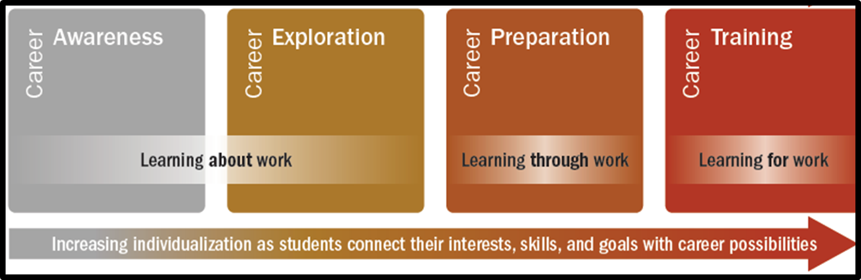
What Is Work-Based Learning?
Notes:
States and districts are increasingly looking to design, scale, and implement work-based learning such as apprenticeships, internships, service learning, and simulations as a strategy to improve students’ readiness for careers. Integrating work-based learning experiences from secondary and postsecondary education is one strategy to enhance learning and provide an opportunity for students to gain critical skills for the future. Work-based learning is a continuum of activities—both inside and outside the classroom—that affords students opportunities to connect what they are learning in the classroom to the world of work. Quality work-based learning offers students the chance to apply academic and technical knowledge to real-world settings, thereby developing crucial employability skills.

Slide 8
Why Work-Based Learning Measures Matter
Students
Reflect on learning from work-based learning experiences.
Identify knowledge and skills gained.
Connect application to future career goals.
Schools/Districts/States
Use data to improve the quality of work-based learning experiences for all students.
Notes:
Similar to academic content, there are several benefits for student and for states, districts, and schools to document and measure student learning from work-based learning experiences. For students, measuring work-based learning allows them to reflect on their learning, identify knowledge and skills gained, and connect that learning to future career goals. This can help students explicitly call out the skills learned in a resume or job interview. For states, districts, and schools, measuring work-based learning provides data that can be used for continuous improvement efforts to improve the quality of work-based learning experiences for all students. For example, the data can improve matching students with work-based learning experiences and employers or identifying skills gaps and providing students supplemental support.

Slide 9
Work-Based Learning Measures Options
Notes:
How are other states and districts measuring work-based learning? We’ll now explore the various options for work-based learning measures.

Slide 10


Measures of Work-Based Learning
States reviewed: 17
Districts reviewed: 59
Total resources reviewed: 109
Employer evaluations: 30
Rubrics: 23
Self-assessments/reflections: 19
Worklogs: 7
Portfolios: 5
Notes:
To learn how states and districts measure work-based learning, the College and Career Readiness and Success Center (CCRS Center) conducted a document scan collecting and analyzing work-based learning measures. States selected included leaders in work-based learning and states who specified in their state Every Student Succeeds Act (ESSA) plans that they plan to use work-based learning as an indicator of career readiness in their state accountability. We also collected documents from the largest two to four districts in each state. In addition to the measures, we collected related work-based learning resources, such as guidebooks and presentations, that often include the context on how to implement the measure. We searched for resources publicly available on state or district websites and found a total of 109 work-based learning measures and resources. This included 30 employer evaluations, 23 rubrics, 19 self-assessments or self-reflections, seven worklogs, and five portfolios.

Slide 11
Themes From Work-Based Learning Measures
What Is Measured?
Academic Knowledge
Technical Skills
Employability Skills
Who Measures It?
Students
How Is It Measured?
Portfolios
Rubrics
Employer Feedback
Self-Assessment
Employers
Teachers
Intermediaries
Notes:
Our document analysis identified themes focused on what is measured, how it is measured, and who measures it. What is measured are the skills and knowledge students develop over the course of their work-based learning experience. These include academic knowledge, technical skills, and employability skills. Who measures work-based learning includes students, employers, teachers, and intermediaries. States and districts commonly use the following measures to assess student learning from work-based learning: portfolios, rubrics, employer evaluations, and self-assessments. In some cases, states in our scan used multiple types of measurement tools, such a portfolio that included a rubric and a student self-assessment. As you consider which measure or measures to select, please keep in mind that these measures are not mutually exclusive. Next, we’ll explore in greater detail each of these measures.

Slide 12
Types of Measures: Portfolios
A portfolio is a purposeful collection of student work over time (Herman, Gearheart, & Aschbacher, 1996).
Notes:
A portfolio is a purposeful collection of student learning over time that demonstrates students’ learning progress. Portfolios are used to evaluate what skills and knowledge students learn. Typically, a student will submit in a portfolio student work created over the course of the work-based learning experience; for example, work samples such as presentations, research papers, spreadsheets, business plans, and photos. The creation of the portfolio is typically led by the student but can be a collaborative process with guidance or approval from a teacher or counselor. The student work submitted within a portfolio is scored using a rubric.
In Handout 1, on page 2, there is an example from Ohio of the required components for a work-based learning portfolio. It includes three to four work samples, a writing or research sample, and a project in addition to other artifacts demonstrating career readiness.

Slide 13
Types of Measures: Rubrics
A rubric is a set of scoring guidelines for evaluating student work (Classroom Assessment Scoring System, 1997).
Notes:
A rubric provides the guidelines for evaluating student work and can assess the quality of student skills or knowledge gained across multiple levels of performance. A teacher, counselor, or work-based learning coordinator scores the student work submitted in a portfolio using the rubric.
In Handout 1, on pages 3–4, is a rubric example from Tennessee. This rubric assesses employability skills such as critical thinking, speaking and listening, and collaboration.

Slide 14
Types of Measures: Employer Feedback
Evaluation of work-based learning program quality
Documentation and assessment of a student’s performance of his or her duties or development of skills and knowledge
Notes:
Employer feedback is completed by the employer to document and assess the student’s performance during the experience or the development of his or her skills and knowledge. Employer feedback typically assess students’ traits, behaviors, or the accomplishment of a goal or task. This could include traits such as honesty, behaviors such as professional appearance, and setting a goal that is focused on developing specific skills or completing a task.
Employer feedback could also be used to assess program quality and implementation for work-based learning. For example, you could ask an employer to evaluate to what extent the school provided support and coordination during the work-based learning experience. This could be a way to collect data to make improvements to the program’s quality, improve student and employer match-ups, or identify additional supports needed for employers and students.
In Handout 1, on page 5, is an example of an employer feedback rubric from California. The employer rates the student’s performance on certain traits and behaviors.

Slide 15
Types of Measures: Self-Assessment
Students evaluate or rate their own abilities, skills, and/or performance.
Students write reflections or thoughts on their own abilities, skills, performance, and experiences during the work-based learning experience.
Notes:
For a self-assessment, students evaluate or rate their own abilities, skills, or performance during a work-based learning experience. Students write reflections to open-ended prompts on their work-based learning experience or the development of skills or knowledge.
In Handout 1, on page 6, is an example self-assessment from South Dakota that includes 10 reflection questions. The questions range from what were some of the biggest problems experienced, what did you learn from working with others, what did the program teach you about yourself, and what would you do differently.

Slide 16
Activity: Review Sample Measures
In Handout 1, review the examples of work-based learning measures.
In groups, discuss the following guiding questions on the examples:
  What struck you or what questions emerged from reviewing the examples?
  What are some potential strengths and weaknesses for each type of measure based on the examples?
  What skills or knowledge are measured from the examples?
Notes:
In Handout 1, on pages 2–6, review the example work-based learning measures. In your groups, discuss the guiding questions regarding the examples.

Slide 17
Key Decision Points
Determine goals for measuring work-based learning.
Determine who selects the work-based learning measure.
Define work-based learning knowledge and skills.
Plan for supporting work-based learning measure implementation.
Select work-based learning measure(s).
Notes:
There are five key decision points that you will need to make in order to select an appropriate work-based learning measurement tool that fits your local context and needs. This module will walk you through each of these decisions and provide examples and guidance. The first decision is to determine what your goals are for measuring work-based learning. Second, determine who selects the work-based learning measure. The third decision point is to define the work-based learning knowledge and skills that will be measured. The fourth decision point is to determine your capacity to implement each tool with fidelity. Finally, you can then select your work-based learning measure.

Slide 18
Decision Point 1: Determine Goals for Measuring Work-Based Learning
Notes:
Now that we understand the importance of measuring work-based learning and the types of measures, we’ll review the decision points to select an appropriate measure.
The first decision point is to determine your goals for measuring work-based learning. Your goals for measuring work-based learning can help narrow which type of measure will be the best fit to meet your goals. For example, if your primary goal is to collect data for continuous improvement efforts to your work-based learning programs, then you will want to select a measure that will provide the type of data to help make the needed improvements.

Slide 19
Review Work-Based Learning Definition
28 Formal Definitions
22 workplace experience
9 professional skill development
16 knowledge or technical skill development
4 connected to a career pathway
4 include payment requirement
Giffin, Neloms, Mitchell, & Blumenthal, 2018
Notes:
Reviewing your state’s definition of work-based learning is a great starting point to determine your goals for measuring work-based learning. How you define work-based learning can illustrate what the key components of your program are. The CCRS Center did a scan of state definitions of work-based learning. Here are some common themes we found from the formal definitions of work-based learning. Sixteen definitions focus on knowledge or technical skill development. If that is in your definition, one of your goals could be to measure students’ knowledge and technical skill development.

Slide 20
Activity: Dissecting Definition to Determine Goals
[Insert Your Work-Based Learning Definition on this slide]
Notes:
Let’s take a look at your definition of work-based learning to determine some possible goals. First, review the definition on the slide. As a group, discuss the following guiding questions to help dissect your work-based learning definition to identify some possible goals for work-based learning.
Based on the definition, what are the purposes of work-based learning experiences for students? How might that translate into goals for work-based learning?
What are students expected to learn or do during a work-based learning experience according to the definition? Does that translate to any goals for measuring work-based learning?
Are there any other goals you can see from the definition of work-based learning?

Slide 21
Sample State Work-Based Learning Goals
Accountability
  ESSA
  Perkins
  High school graduation requirements
Career Readiness
  Employer skills development
  Application of academic and technical content in real-world setting
Program Quality
  Quality of work-based learning experience
  Employer engagement in program design
Notes:
States can have several reasons or goals for measuring work-based learning. Some sample state goals could be for accountability, such as meeting ESSA requirements or high school graduation requirements. States may want to measure work-based learning to document student career readiness, such as the development of employability skills or application of technical content in the real world. Finally, states may want to measure work-based learning to assess program quality, such as collecting data on the quality of the work-based learning experience or employer engagement.
The state’s goal for measuring work-based learning may help inform what type of measure is most appropriate. For example, some states noted in their state ESSA plans to use work-based learning as an indicator of career-readiness in accountability systems. States with this goal may need different measures that provide more quantifiable data that can be used for accountability. This is not an exhaustive list of potential goals, so your state or district may have other goals.

Slide 22
Discussion: Determine Goals for Measuring Work-Based Learning
In your teams, determine your goals for measuring work-based learning.
Reflect back on the possible goals identified from your definition of work-based learning.
Capture your notes from the discussion and your final decision on the handout for Decision Point 1.
Notes:
In your team, use the Decision Point 1 handout and your definition of work-based learning to help determine your goals for measuring work-based learning.

Slide 23
Decision Point 2: Determine Who Selects the Work-Based Learning Measure
Notes:
The next decision to select an appropriate measure of work-based learning is to determine who decides on the work-based learning measure. Is this something the state will require, or do districts have some flexibility in adjusting measures to fit the needs of their students and local businesses?

Slide 24



Who Selects Measure
State
District
School
Notes:
If your team consists of representatives from state-level agencies, you may have greater authority to determine who selects the measure and the level of flexibility. There are three options for who may select the work-based learning measure. The first is a statewide required or recommended work-based learning measure. If the SEA requires all districts and schools to use the same work-based learning measure, it can help ensure comparability across students and districts. Because the data will be comparable, the state could more easily use the data to make policy decisions to improve the quality of work-based learning programs for all students. However, there may be a wide variety of work-based learning opportunities and types of employers across the state, which may make it difficult to use a common measure. Schools may have varying levels of capacity to implement the work-based learning measure. Recommending a measure with some flexibility may help achieve some comparability and reduce the capacity challenges while maintaining some local flexibility.
The next option is the state may allow districts to require or recommend a work-based learning measure. Districts are less likely to have as wide a variety of types of employers from different industries and will have a better understanding of the capacity challenges for each school. Permitting districts to determine the work-based learning measure does limit the comparability at the state-level. In addition, districts may not be able to adjust measures to meet the specific needs and interests of students. Students may need to focus on developing specific skills and knowledge based on their own strengths and weakness, interests, and work-based learning experience.
The state and district may give schools the flexibility to select the work-based learning measure with students. This option can promote personalization and ensure that the experience is focused on developing the specific knowledge and skills the student needs based on his or her strengths and weaknesses and career interests. In addition, the measure can align more closely to the work-based learning experience; for example, measuring technical knowledge and skills that are specific to the career or industry of the work-based learning experience. The technical skills may be too specific for other industries to use to measure for all work-based learning experiences. However, this will limit the comparability even at the district level and may require additional training and support to students and educators to select an appropriate measure to meet the student needs.

Slide 25
Flexibility Options
Type 1
School selects measure
Type 2
Districts require measure
Type 3
SEA recommends measure with some local flexibility
Type 4
SEA require same work-based learning measure
Increasing Measure Alignment to Experience
Increasing Measure Comparability
Notes:
Another key component to determining who selects the work-based learning measure is to consider the flexibility options. The amount of flexibility on who selects the work-based learning measures lies on this spectrum between comparability and alignment to student’s work-based learning experience. The measure’s alignment to the work-based learning experience refers to the flexibility of schools to select work-based learning measures based on the students interests, strengths and weaknesses, and the work-based learning experience. Comparability refers to how similar the work-based learning measures are among students across schools, districts, or the state. States and districts will need to balance this issue of comparability versus alignment to the work-based learning experience as they determine who should select the work-based learning measure.

Slide 26
Alignment to Goals
Goals | State | District | School
Accountability | X
Workplace readiness | X | X | X
Knowledge or technical skill development |  | X | X
Experience in real workplace settings | X | X | X
Connect to career pathway |  | X | X
Notes:
The goals or purpose for why you are measuring work-based learning can also help determine the level flexibility and who should select the work-based learning measure. If your goal is to measure student learning from work-based learning for accountability purposes, then it may be more important that your measures are comparable across districts and schools. This means that you may want the state to select the measure or provide a menu of measures and tools for districts to choose from. If your main goal is to measure student knowledge or technical skill development, then it may be important to let districts and schools determine the measures. Districts and schools can have a better sense of the types of knowledge and skills employers may need in their local communities because the labor market in their regions may be different from statewide trends.

Slide 27
Discussion: Who Selects the Work-Based Learning Measures
In your teams, discuss who should select the work-based learning measures.
Capture your discussion notes and final decision on the handout for Decision Point 2.
Notes:
In your team, discuss who should select the work-based learning measures. Capture your final decision and notes from the discussion on the handout for Decision Point 2.

Slide 28
Decision Point 3: Define Work-Based Learning Knowledge and Skills
Notes:
Once you’ve determined your goal for measuring work-based learning, the next decision point is to define work-based learning knowledge and skills. In other words, what is measured.

Slide 29
Types of Knowledge and Skills
Academic Knowledge
Knowledge and skills associated with subject-matter areas such as English, mathematics, and science
Technical Skills
Skills needed for specific occupations or careers
Employability Skills
General knowledge and skills that are necessary for success in the labor market at all employment levels in all sectors
Source: Staz, 2001
Notes:
There are three key types work-based learning knowledge and skills. Work-based learning measures may focus on one type or include multiple types of knowledge and skills. The first is academic knowledge. These are often the same knowledge we associate with subject-matter areas such as English, mathematics, and science. Many of the same academic knowledge areas are transferable to the world of work, and students will need this knowledge to succeed in their future careers. However, students may have plenty of opportunities to practice and demonstrate this knowledge in the classroom. States and districts may instead be more interested in capturing other skills and knowledge that are not as easy to develop or practice in the classroom specific to career-readiness.
The second type is technical skills, which are the skills specific to particular occupations, careers, or industries. These are skills that are not necessarily transferable to every job at every level; for example, the skills to operate technical equipment such an x-ray or in licensed careers such as cosmetology. These skills are very career specific, but it may be difficult to measure these skills for every student and work-based learning experience. It may require defining a specific set of technical skills and knowledge specific for several types of industries or career clusters. This approach may require additional training and support for students and school staff.
The next type of skills is employability skills, which are the general knowledge and skills that are necessary for success in the labor market at all employment levels in all sectors. These skills could work for multiple occupations, across multiple industries, and at every level; for example, skills such as communication and problem solving. Because these skills are more universal, it will require less training and support for students and school staff than technical skills. However, these skills will not be specific to the occupation, industry, or work-based learning experience.
Next, we’ll share some examples of each type of knowledge and skill.

Slide 30
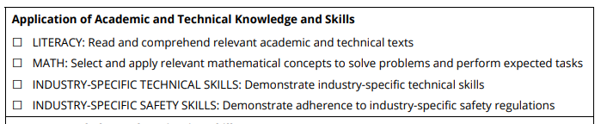
Academic Knowledge Example: Tennessee
Source: Tennessee Department of Education, n.d.
Notes:
This is a portion of a checklist from the Tennessee Department of Education (TDOE), outlining the competencies on which students are assessed from their work-based learning experiences. It includes application of academic and technical knowledge and skills with a focus on literacy and math. Tennessee’s checklist also includes other types of skills and knowledge. Two hundred twenty-five stakeholders from across Tennessee vetted this list through focus groups with TDOE, including administrators, teachers, work-based learning coordinators, CTE directors, and postsecondary and industry representatives.

Slide 31
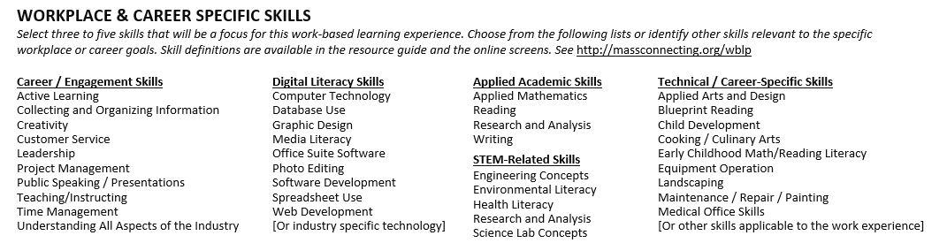
Technical Skills Example: Massachusetts
Notes:
Here is an example of technical skills that Massachusetts measures for work-based learning. This list highlights some industry-specific technical knowledge and skills such as engineering concepts, web development, and medical office skills.

Slide 32
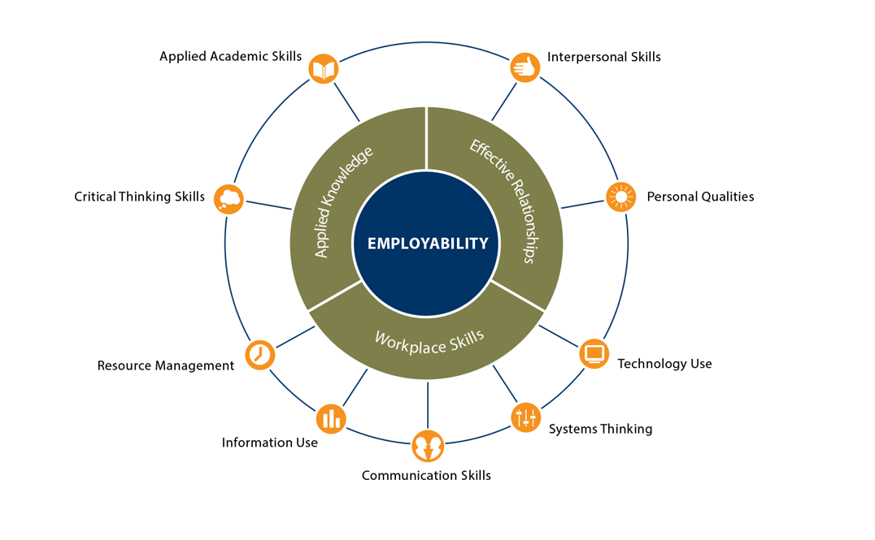
Employability Skills Framework
Notes:
This is the employability skills framework developed by the Office of Career, Technical, and Adult Education at the U.S. Department of Education. Employability skills are the general skills and knowledge that are necessary for success in the labor market at all employment levels and in all sectors. These skills are not career- or industry-specific skills. They include things like interpersonal skills, personal qualities, technology use, systems thinking, communication skills, information use, resource management, critical thinking skills, and applied academic skills. This type of universal skills may be the type of skills you want to measure from a student’s work-based learning experience.

Slide 33
What Can Each Measurement Tool Assess?
 | Portfolio | Rubric | Employer Feedback | Self-Assessment
Academic Knowledge | X | X
Technical Skills | X | X | X
Employability Skills | X | X | X | X
Notes:
As you determine what knowledge and skill to assess, reflect back on your goals of measuring work-based learning. Were there particular skills or knowledge identified in your goals or definition of work-based learning? Once you’ve identified the types of knowledge and skills, you can narrow your options for the type of measures.
What can each type of measurement tool assess? Portfolios and rubrics can measure academic knowledge, technical skills, and employability skills. However, it may be challenging for states and districts to use these measures if they plan to assess only technical skills because it may be burdensome to create multiple industry-specific rubrics. Employer feedback can assess technical skills and employability skills. In addition, this measure can assess observable job tasks or mutually identified goals. Employers may not have enough comprehensive knowledge to assess students on academic knowledge. Self-assessments can measure employability skills. Self-assessments may be used as an artifact within portfolios and could contribute to measuring technical skills and academic knowledge. However, as a stand-alone measure, it is self-reported by students who may not have a deep enough understanding to accurately self-assess their academic knowledge or technical skills.

Slide 34
Discussion: Knowledge and Skills
In teams, discuss which types of knowledge and skills you will assess.
Capture your notes and final decision on Part A of the Decision Point 3 handout on page 10.
Notes:
Discuss which types of knowledge and skills you want to assess from student work-based learning experiences. Capture your notes and final decision on the Decision Point 3 handout.

Slide 35



Types of Stakeholders
SEA or LEA Leaders
School Staff
Business and Industry
Notes:
Engaging a variety of stakeholders can help policy leaders at all levels define the essential knowledge and skills students need to learn from their work-based learning experience and graduate college and career ready. There are three key groups of stakeholders who can provide useful insight and feedback on the knowledge and skills measured from a work-based learning experience. The first is policy leaders from the SEA or local education agency (LEA). State and district policymakers may have access to data on the types of work-based learning experiences students participate in or what the growing business and industries are in your state or region.
The next group of stakeholders is various school staff such as teachers, administrators, school counselors, CTE teachers, and work-based learning coordinators. Often, this is the staff who will be leading the implementation of the work-based learning activities. They may have the personal connections to employers who provide work-based learning experiences to students, provide the support to students to help them prepare to participate in work-based learning, and will likely help implement any work-based learning measures. They may know the specific skills that employers who provide the work-based learning experiences are looking for and may be able to help scaffold the skills and knowledge for students to meet.
The last group of stakeholders who can provide insights on defining the knowledge and skills are representatives from business and industry. Education leaders at all levels may not be as familiar with the specific skills and knowledge that are necessary to be successful in the workplace, particularly for specific technical skills. Business and industry can help clarify what employability skills and technical skills students will need to develop over the course of their work-based learning experience. However, business and industry alone may not be sufficient to define the knowledge and skills because this group may be unfamiliar with how to modify or scaffold these skills to the student level. Students will more likely than not be able to demonstrate career knowledge and skills at the same level as the adults with whom business and industry typically work.

Slide 36
Discussion: Finding the Right Business and Industry Stakeholders
Using Part B of the Decision Point 3 handout, respond to the guiding questions to identify key business and industry stakeholders.
Capture your notes from the discussion and a list of your stakeholders on the handout.
Notes:
Use the guiding questions in Part B of the Decision Point 3 handout to brainstorm and identify business and industry stakeholders to help define the relevant knowledge and skills.

Slide 37



Approaches to Collect Feedback
In-Person Meeting
Survey or Focus Groups
Review and Comment
Notes:
There are a couple of key approaches for how a state or district can collect feedback to define the knowledge and skills. The first approach is to convene an in-person meeting of stakeholders. This approach allows state and district policymakers to collect feedback directly. This meeting could have the stakeholders work together to help develop the list of knowledge and skills or to vet a list developed internally at the SEA or LEA. This approach will require inviting stakeholders and facilitating the discussion to maximize the stakeholders’ time.
Another approach to collect stakeholder feedback is to conduct a survey or focus groups. This methodology allows you to gather input without having to coordinate inviting stakeholders to meet. If you choose this approach, you will need to consider how to develop the survey or focus group protocol and how you will analyze the feedback.
The last approach is to develop a list of skills and knowledge and ask a variety of stakeholders to review or provide comments. This approach is less burdensome and time consuming for stakeholders and allows them react to a predeveloped list. However, this approach may discourage stakeholders from adding any important skills or knowledge to the list because they may only provide comments about what is listed rather than add anything that may be missing.

Slide 38
Activity: Defining Knowledge and Skills
Review the possible knowledge and skills from the Skills Bank table on pages 12–18 in the handout.
Solicit feedback from your stakeholders on your final list of knowledge and skills to assess and capture your final list on Part C of the Decision Point 3 handout.
Notes:
Review the possible knowledge and skills to assess work-based learning from the Skills Bank table on pages 12 to 18 in the handout. You may want to solicit feedback from stakeholders identified in Part B to develop a final list of knowledge and skills to assess. Capture the final list of knowledge and skills on Part C of the Decision Point 3 handout.

Slide 39
Additional Resources on Stakeholder Engagement
Identifying and Engaging Key Stakeholders and Defining Goals of the Career Pathways System, the CCRS Center
Moving Toward Equity Stakeholder Engagement Guide, the Center on Great Teachers and Leaders
Communications and Engagement Assessment Rubric and Facilitator’s Guide, Reform Support Network
Meaningful Local Engagement Under ESSA, CCSSO
Career Readiness Stakeholder Engagement Tool, New Skills for Youth
Notes:
You may want to consider additional strategies to engage stakeholders not only to define the knowledge and skills to measure but throughout the entire process. Stakeholder input will be valuable to select an appropriate measure, determine what knowledge and skills to measure, and to help develop the measure. This slide includes links to additional resources and guidance on identifying appropriate stakeholders and strategies for stakeholder engagement. Some are focused on other initiatives such as career pathways or ESSA, but the strategies and techniques can be applicable to work-based learning.

Slide 40
Decision Point 4: Plan for Supporting Work-Based Learning Measure Implementation
Notes:
Once you’ve identified your goal for measuring work-based learning and what you plan to measure, it is important to examine your existing and needed capacity to implement the measure with fidelity. Some measures may require additional support or guidance for students, teachers, and employers.

Slide 41
Factors of Implementation Success
Training and Resources
Calibration
Communication
Stakeholder Engagement
Notes:
In order to successfully implement any work-based learning measure, it will require some capacity and supports from states, districts, and schools. There are four factors of implementation success, and each measure requires a different level of capacity to implement.
The first factor is training and materials. Once you’ve developed your work-based learning measure, it may require some additional training and resources that are differentiated by various stakeholders such as students, employers, and school staff. For example, if you decide to use a portfolio and rubric, students, work-based learning coordinators, and counselors will need training on the rubric and guidance on how to put together the portfolio. However, a student self-assessment may require less training and resources such as guidance for students on how to complete the self-assessment.
In order to ensure that the work-based learning measure accurately assesses the identified skills and knowledge, it will require some calibration. Calibrating a measure will ensure that all users have the same understanding of the knowledge and skills assessed and how to interpret and score them via the measure. For example, do employers, students, and school counselors have the same understanding of the rubric and score students consistently? Training and materials may help with calibration efforts by providing all stakeholders with a similar understanding of the measure and how it is used accurately. However, some measures may be more intuitive than others for the various stakeholders to use accurately. For example, you’ll want to make sure that both school staff and employers have the same understanding of the various skills and knowledge measured for work-based learning. Sometimes the skills assessed such as communication seems intuitive, but the measure requires a specific understanding of that skill in order for it to be measured accurately.
Each measure will require different levels of communication to various stakeholders and users. For example, a portfolio and rubric will require consistent communication between school staff and employers hosting the work-based learning experience. Schools may need to articulate early that they’ll want to collect work samples from the students’ experience, and they may require permission or advance approval from employers. In addition, schools will need to communicate their needs for measuring work-based learning with their employer partners from the beginning and throughout the experience when collecting feedback.
Each measure may vary in the level of stakeholder engagement needed. For example, employer feedback will require more responsibility and involvement from employers and business and industry partners. You may want to be careful that you do not overburden your employer partners who are providing the work-based learning experiences for your students. However, employers do have a unique perspective and can provide valuable insight on the skills and knowledge students develop. You may want to provide additional supports and training to help reduce the burden to employers. Similarly, other measures may require a greater responsibility for students such as portfolios and self-assessments. This may be a benefit by encouraging student efficacy and greater ownership in the process. However, students may also need additional supports and guidance to implement with fidelity.
Next, we’ll explore the level of intensity for each of these implementation factors for each work-based learning measure.

Slide 42
Level of Intensity for Each Factor
 | Portfolios | Rubric | Employer Feedback | Self-Assessment
Training and Resources | High | High | Medium | Low
Calibration Needs | High | High | Medium | Low
Communication | High | High | High | Medium
Stakeholder Engagement | Medium | Medium | High | Low
Notes:
This table highlights the level of intensity to implement each measure for each of the implementation success factors. A high-level of intensity means that this measure will require a greater focus on the implementation factor compared with a low-level intensity. For example, portfolios will require a greater focus on training and resources to successfully implement than student self-assessments.
To implement portfolios and rubrics, you will need to provide training to educators, school counselors, and employers on the rubric, how to review student work using the rubric, and providing feedback to students. This training may need to be differentiated for each stakeholder group because their role in the portfolio process may be different. In addition, you will need to create guidance on how to complete a portfolio for students, school staff, and/or employers. The types of student work that can be included in the portfolio may need to be specified and guidance on how each work sample can demonstrate the skills or knowledge outlined in the rubric. In addition, you may need to provide training and guidance to students, educators, and employers to ensure that they all have a similar understanding of the rubric and to help calibrate all stakeholders’ understanding. Portfolios and rubrics will require communication to coordinate the completion and scoring of the portfolio with students, school staff, and employers.
For employer feedback, employers will need guidance on how to complete the evaluation and provide students with feedback. Your employer feedback form may seem intuitive to employers or mentors, but they may have a different understanding of what the skills and knowledge assessed means. In addition, you will need a dedicated school staff person such as a work-based learning coordinator or counselor to provide support and guidance to employers. This person often serves as the point of contact for employers and provides guidance to employers and collects the evaluation forms. In partnering with employers, you will need their time and commitment to accurately complete evaluations. You do not want to overburden employers so that they do not complete the employer feedback fully or lose their participation as a partner.
For self-assessments, students will need guidance on how to complete each one, including a clear understanding of the skills and knowledge being measured. School staff may also need guidance and training on how to provide students with feedback based on the results or reflections. This measure will require some communication with students, but, because this is a self-reported measure, there are fewer training and calibration needs compared with other measures. This illustrates how student self-assessments as a stand-alone measure are not high-quality to be used for accountability purposes.

Slide 43
Discussion: Plan for Supporting Work-Based Learning Measure Implementation
Using the Decision Point 4 handout on page 19, consider the different factors that support quality implementation. Capture your notes on anything important to consider.
As a group, identify which stakeholders will take responsibility for leading the specific implementation factors and the timeline for addressing it.
Notes:
Using the Decision Point 4 handout, consider the different factors that support quality work-based learning measure implementation. Identify which stakeholders will take responsibility for each leading implementation factor and the timeline for addressing it.

Slide 44
Decision Point 5: Select Work-Based Learning Measure(s)
Notes:
Once you’ve completed Decision Points 1–4, you are now ready to select your work-based learning measure.

Slide 45
Activity: Selecting Work-Based Learning Measure
Refer to Handout 1, Decision Point 5.
In groups, discuss the guiding questions, and review your discussion from the earlier decisions point to select your work-based learning measure and develop next steps.
Notes:
Using Handout 1, Decision Point 5, discuss the guiding questions in your group to help select your work-based learning measure based on your selections from Decision Points 1–4. Reviewing your decisions, select which work-based learning measure is the best fit for your local context. The guiding questions will also help identify your next steps.

Slide 46
Wrap-Up

Slide 47
Key Decision Points
Determine goals for measuring work-based learning.
Determine who selects the work-based learning measure.
Define work-based learning knowledge and skills.
Plan for supporting work-based learning measure implementation.
Select work-based learning measure(s).
Notes:
This module walked you through the five key decision points needed to select an appropriate work-based learning measure to fit your local context. The first was to determine what your goals are for measuring work-based learning. Next, you determined who selects the work-based learning measure. The next decision point was to define the work-based learning knowledge and skills. The next decision point was to determine your capacity to implement the various measures with fidelity. And finally, based on these decisions, you selected your work-based learning measure.

Slide 48
Additional Modules
Additional modules that outline the decision points needed to develop each measure.
Module 2: Developing Portfolios
Module 3: Designing Rubrics
Module 4: Constructing Employer Feedback and Evaluation
Module 5: Creating Student Self-Assessments
Notes:
Once you’ve selected your measure, we have additional modules that outline the necessary decisions points needed to develop each measure covered here. The second module focuses on portfolio, and the third module highlights the decision points to develop a rubric. The fourth module digs into employer feedback, and the final module looks at self-assessments.

Slide 49
References
Classroom Assessment Scoring System. (1997). Rubrics and scoring guidelines and examples. Retrieved from https://www.iup.edu/WorkArea/DownloadAsset.aspx?id=129844
Giffin, J., Neloms, G., Mitchell, A., & Blumenthal, D. (2018). Work-based learning definitions: Themes from states and national organizations. Washington, DC: College and Career Readiness and Success Center. Retrieved from https://ccrscenter.org/sites/default/files/WorkBasedLearning_StateDefinitions.pdf
Herman, J. L., Gearheart, M., & Aschbacher, P. R. (1996). Portfolios for classroom assessment: Design and implementation issues. In R. Calfee & P. Perfumo (Eds.), Writing portfolios in the classroom: Policy and practice, promise and peril (pp. 27–62). Mahwah, NJ: Erlbaum. Retrieved from http://files.eric.ed.gov/fulltext/ED398588.pdf
Massachusetts Department of Elementary and Secondary Education. (n.d.). Massachusetts work-based learning plan. Malden, MA: Author. Retrieved from http://skillspages.com/documents/masswblp.doc

Slide 50
References
Ohio Department of Education. (2016). Suggested components of a work-based learning portfolio. Columbus, OH: Author. Retrieved from https://www.google.com/url?sa=t&rct=j&q=&esrc=s&source=web&cd=2&ved=2ahUKEwi91J7K-MPhAhUk6oMKHWx4CzkQFjABegQIAhAC&url=https%3A%2F%2Feducation.ohio.gov%2Fgetattachment%2FTopics%2FCareer-Tech%2FCareer-Connections%2FWork-Based-Learning%2FWork-Based-Learning-for-Schools-and-Educators%2FSuggest-Components-of-a-WBL-Portfolio.docx.aspx&usg=AOvVaw2TyFta4e0dnYrym_5geEFs
South Dakota Department of Education. (n.d.). Youth internship program framework. Pierre, SD: Author. Retrieved from http://doe.sd.gov/octe/documents/YI_Manual.pdf
Staz, C. (2001). Assessing skills for work: Two perspectives. Oxford Economic Papers, 53(3), 385–405.
Tennessee Department of Education. (n.d.). Employability skills checklist. Nashville, TN: Author. Retrieved from https://www.tn.gov/content/dam/tn/education/ccte/wbl/wbl_employability_skills_checklist.pdf

Slide 51
References
Tennessee Department of Education. (n.d.). Student self-assessment of skills. Nashville, TN: Author. Retrieved from https://www.tn.gov/content/dam/tn/education/ccte/wbl/wbl_wbl_student_self_assessment_of_skills.pdf
Tennessee Department of Education. (n.d.). Student skills assessment rubric. Nashville, TN: Author. Retrieved from https://www.tn.gov/content/dam/tn/education/ccte/wbl/wbl_student_skills_assessment_rubric.pdf

Slide 52
1000 Thomas Jefferson Street NW
Washington, DC 20007
800-634-0503
www.ccrscenter.org | ccrscenter@air.org
This work was originally produced in whole or in part by the College and Career Readiness and Success Center with funds from the U.S. Department of Education under cooperative agreement number S283B120034. The content does not necessarily reflect the position or policy of the Department of Education, nor does mention or visual representation of trade names, commercial products, or organizations imply endorsement by the federal government.
Copyright © 2019 American Institutes for Research. All rights reserved.

