Slide 1
Chapter 1: Identifying and Engaging Key Stakeholders and Defining Goals of the Career Pathways System

Slide 2
Meeting Objectives
Build team knowledge of career pathways.
Define the goals of a career pathways system in our state.
Ensure commitment to the career pathways initiative.

Slide 3
Meeting Agenda
Welcome and Introductions
Review Roles and Responsibilities
Introduction to Career Pathways
Defining Career Pathways
Activity: Developing a Working Definition of Career Pathways

Slide 4
Welcome and Introductions

Slide 5
Welcome and Introductions

Slide 6
Review Roles and Responsibilities

Slide 7
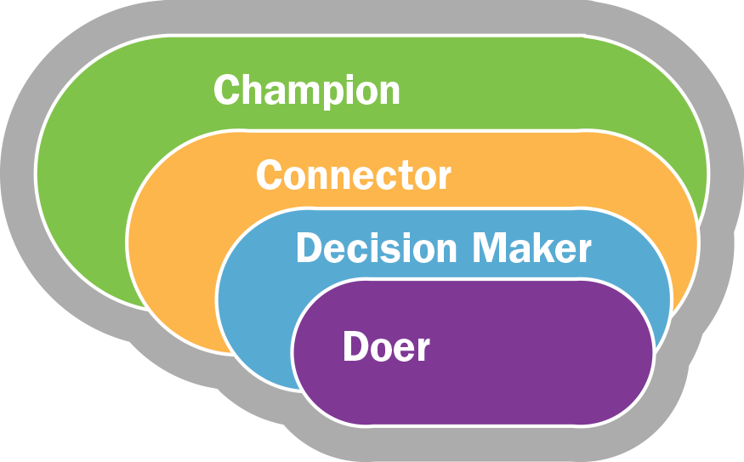
Roles and Responsibilities Overview

Slide 8
Role of the Champion
Role | Responsibilities | Level of Engagement
Champion | Advocate for a statewide career pathways system to their network. Leverage position, connections, or relationships to build buy-in for the initiative. Share information with broader stakeholders. Represent stakeholders at all levels, such as teachers, program administrators, and policy advisors. | Everyone should be a champion in some capacity, as everyone has a responsibility to advocate for the initiative. However, there should be key individuals who have influence and visibility to secure resources and political will to move the career pathways work forward. It is understood that these champions may not have time to do all of the career pathways work, so champions may designate staff to complete the work.

Slide 9
Role of the Connector
Role | Responsibilities | Level of Engagement
Connector | Make connections between people and initiatives. Leverage and identify resources. Share information with stakeholders. | There should be a few key people involved who can make connections with other work or resources across the state.

Slide 10
Role of the Decision Maker
Role | Responsibilities | Level of Engagement
Decision maker | Review materials at key points. Make critical decisions and approve materials. Contribute to the work as an expert. Advise others on approach and next steps. Provide initial considerations or insights for the work. Review materials at key points. | Decision makers should be experts who are able to set the vision and direction of the work. There should be at least one decision maker from each sector to be included in the career pathways system. Decision makers also may be champions with influence and visibility. Decision makers should bring members of their staff who can serve as doers.

Slide 11
Role of the Doer
Role | Responsibilities | Level of Engagement
Doer | Lead and complete major pieces of the work. Gather critical information. Keep activities and projects moving forward. | There should be a few stakeholders from each sector who are responsible for doing the majority of the work during the course of the initiative.

Slide 12
Group Activity: Commitment to the Work
Identify the role you most align with.
Discuss your ability to commit to the requirements of this role.
Discuss the importance of building a career pathways system:
You as an individual
Your agency
How can you or your agency contribute to the effort?

Slide 13
Introduction to Career Pathways

Slide 14
Why Career Pathways—Jobs
Growing need for better educated, higher skilled workforce
Most jobs require some postsecondary education
Skills gap results in mismatch between job openings and available workers
Notes:
Labor, Business, and Industry
Growing need for better-educated, higher-skilled workforce
Jobs requiring some postsecondary education increasing
Share of jobs grew from 28% to 59% over last four decades
Expected to reach 65% by 2020 (Carnevale, Smith, & Strohl, 2013)
Skills gap: mismatch between job openings, available workers
ManpowerGroup’s 2015 survey of hiring managers in 42 countries and territories, 38% of employers reported having difficulty filling jobs, up two percentage points from the previous year (ManpowerGroup, 2015)
The Manufacturing Institute reports that 2 million of the 3.5 million manufacturing jobs that need to be filled in the next decade will go unfilled (Manufacturing Institute, 2015Secondary Education
Disengagement/Dropout:
High school graduation rate increasing but only at 81.4% (DiPaoli, et al., 2015)
Lack of counseling, resources to support students in identifying pathways

Slide 15
Why Career Pathways—Students
Lack of resources to identify pathways
Two thirds of students enrolling in two- or four-year programs
20 percent of students must take remedial coursework
Low postsecondary completion rates
Mismatch between degrees and available jobs
Notes:
Disengagement/Dropout:
High school graduation rate increasing but only at 81.4% (DiPaoli, et al., 2015)
Lack of counseling, resources to support students in identifying pathways
Enrollment:
Among high school graduates, only 66% enroll in a 2- or 4-year degree program following fall (NCES, 2014)
Remediation:
20% of first-time enrolled students must take remedial coursework (NCES, 2014)
Low Completion Rates:
31% of students at 2-year colleges earn a degree or certificate in 3 years and only 59% of students at 4-year colleges and universities finish in 6 years (NCES, 2014)
Mismatch between majors, degrees, and available jobs/careers

Slide 16
Why Career Pathways—Economy
Lost economic opportunity
Disproportionally high unemployment for specific groups of students
Notes:
Society
Lost Economic Opportunity
The cost of lost economic opportunity for a high school dropout is estimated at $258,240 over a lifetime and $755,900 for society as a whole (Belfield, Levin & Rosin, 2012)
Increasing the high school graduation rate to 90% would result in $8.1 Billion in increased earnings across the nation (Alliance for Excellent Education, 2013)

Slide 17
Activity: Individual Beliefs of a Career Pathways System
Why is a career pathways system a priority to you and your agency?

Slide 18
Defining Career Pathways

Slide 19
Activity: Defining Career Pathways
Brainstorm activity:
On your own, generate a list key elements of a career pathways system.
Record your list on a sticky note.
Discuss your list with your table.

Slide 20
Defining Career Pathways
Different career pathways definitions exist.
Alliance for Quality Career Pathways (CLASP)
Departments of Education, Health and Human Services, Labor
Department of Education, Office of Career, Technical, and Adult Education (OCTAE)
Pathways to Prosperity Network (Jobs for the Future)
Department of Labor

Slide 21
Department of Labor Definition
A comprehensive career pathways system includes six key elements:
Build cross-agency partnerships and clarify roles.
Identify sector or industry and engage employers.
Designer education and training programs.
Identify funding needs and sources.
Align policies and programs.
Measure system change and performance.
Notes:
Six Key Elements for a comprehensive career pathways system. These elements often happen simultaneously, or are revisited as programs are developed and your local, regional, and state systems evolve:

Slide 22
OCTAE Definition
Career pathways and career clusters are important for career and technical education (CTE) programming:
Programming is governed by the Carl D. Perkins Career and Technical Education Act.
Career clusters are subdivided into career pathways.
Notes:
Career clusters are broad groups of occupations and industries (e.g., health)

Slide 23
Departments of Education, Health and Human Services, Labor Definition
Career pathways are a series of connected education and training strategies and supports that enable individuals to secure industry-relevant certification and obtain employment within an occupational area and to advance to higher levels of future education and employment in that area. Essential components include:
Rigorous, sequential, connected, and efficient curricula
Multiple entry and exit points
Specific focus on local workforce needs, aligned with the skill needs of targeted industry sectors
Credit for prior learning and other strategies that accelerate the advancement of the participant
Services that focus on industry-recognized credentials, sector-specific employment, and advancement
Notes:
Alignment of secondary and postsecondary education with workforce development systems and human services;
Rigorous, sequential, connected, and efficient curricula, that “bridges” courses to connect basic education and skills training and integrate education and training;
Multiple entry and exit points;
Comprehensive support services, including career counseling, child care and transportation;
Financial supports or flexibility to accommodate the demands of the labor market in order to allow individuals to meet their ongoing financial needs and obligations;
Specific focus on local workforce needs, aligned with the skill needs of targeted industry sectors important to local, regional or state economies, and reflective of the active engagement of employers;
Curriculum and instructional strategies appropriate for adults that make work a central context for learning and work readiness skills;
Credit for prior learning and other strategies that accelerate the educational and career advancement of the participant;
Organized services to meet the particular needs of adults, including accommodating work schedules with flexible and non-semester-based scheduling, alternative class times and locations, and the innovative use of technology;
Services that have among their goals a focus on secondary and postsecondary industry recognized credentials, sector specific employment, and advancement over time in education and employment within a sector; and,
Is founded upon and managed through a collaborative partnership among workforce, education, human service agencies, business, and other community stakeholders.

Slide 24
Alliance for Quality Career Pathways (CLASP) Definition
Essential elements include:
Multiple entry points for skill development
Multiple exit points into the workforce
Well-connected and transparent education, training, credentialing, and support services
Four key functions include:
Quality education and training
Nonduplicative assessments
Support services and career navigation
Employment and work experience

Slide 25
Pathway to Prosperity Network Definition
Career pathways structure education, training, and career advancement in a seamless continuum to enable young people to build academic and technical skills, attain postsecondary credentials with labor-market value, and launch careers in high-demand, high-growth, high-wage industries while leaving open the prospect of further education. Cross-sector stakeholder groups design and implement pathways that reflect regional contexts. Key elements of pathways include:
Multiple entry and exit points
Rigorous curriculum that integrates core academic content and career-focused learning
Opportunities for high school students to earn at least 12 college credits through dual enrollment
Early and sustained career information and advising systems
A continuum of work-based learning opportunities, including paid internships, in which employers are actively engaged
Strong cross-sector partnerships supported by intermediaries

Slide 26
Prioritize Career Pathways Elements

Slide 27
Activity: Prioritizing Career Pathways Elements
Break into groups of two.
Review Handout 1C: Common Career Pathways System Definitions
Prioritize the elements of the definitions you would like to incorporate in your state career pathways framework.
Discuss with the full group.

Slide 28
Example Prioritization Activity
Chart Priority Element | Tally of Importance
Continuum of workplace learning opportunities | X X X X
Nonduplicative assessments | X X X X X X
Multiple entry and exit points | X X
Alignment of policies and programs | X X X X X

Slide 29
Recap and Next Steps

Slide 30
Recap and Next Steps
Next steps:
Develop working definition of a career pathways system and key elements of the system.
Conduct a policy scan to identify alignment of current policies with the working definition.

Slide 31
Presenter Name
XXX-XXX-XXXX
xxxxx@xxxxx
Address
Phone
Website

