Slide 1

Module 5: Creating Student Self-Assessments
Work-Based Learning Measures Series
  [Insert Name]
    [Insert Position]
      [Insert Month 20XX]
Notes:
Thank you for visiting the College and Career Readiness and Success Center’s (CCRS Center’s) series Work-Based Learning Measures. You are in Module 5: Creating Student Self-Assessments. This module explores the benefits of student self-assessments for measuring work-based learning experiences and discusses the decision points needed to develop a student self-assessment.

Slide 2
Work-Based Learning Module Series
Module 1: Selecting Appropriate Measures
Module 2: Developing Portfolios
Module 3: Designing Rubrics
Module 4: Constructing Employer Feedback and Evaluation
Module 5: Creating Student Self-Assessments
Notes:
This module is part of a five-part series. We recommend that you first review Module 1: Selecting Appropriate Measures before continuing in this module. The first module provides an overview of the various types of measures and outlines decision points needed to select which type of measure will best fit your local context and needs. Module 2 focuses on the decision points needed to develop a work-based learning portfolio, and Module 3 shares the decision points needed to design rubrics. Module 4 outlines the decision points to develop and collect employer feedback. This module, Module 5, digs deep into the decision points needed to develop a student self-assessment.

Slide 3
Objectives
Understand how self-assessments can be used to measuring work-based learning experiences.
Discuss the key decisions in creating a student self-assessment to assess work-based learning.
Notes:
Our objectives for this module are to help you understand the benefits of student self-assessments for measuring work-based learning and discuss the decision points needed to develop a self-assessment.

Slide 4
Overview of Self-Assessments
Notes:
Before we discuss the decision points, we want to provide an overview of student self-assessments and their benefits for measuring work-based learning.

Slide 5


Measures of Work-Based Learning
States reviewed: 17
Districts reviewed: 59
Total resources reviewed: 109
Employer evaluations: 30
Rubrics: 23
Self-assessments/ reflections: 19
Worklogs: 7
Portfolios: 5
Notes:
To learn how states and districts measure work-based learning, the CCRS Center conducted a document scan collecting and analyzing work-based learning measures. States selected included leaders in work-based learning and states that specified in their state Every Student Succeeds Act (ESSA) plans that they plan to use work-based learning as an indicator of career readiness in their state accountability. We also collected documents from the largest two to four districts in each state. In addition to the measures, we collected related work-based learning resources such as guidebooks and presentations that often include the context on how to implement the measure. We searched for resources publicly available on state or district websites and found a total of 109 work-based learning measures and resources. This included 30 employer evaluations, 23 rubrics, 19 self-assessments or self-reflections, seven worklogs, and five portfolios. The information and decision points were developed based on an analysis of the document scan and a literature scan on each type of measure.

Slide 6
What Can Student Self-Assessments Do?
Allow students to reflect and monitor their own learning (Brown & Harris, 2013)
Can have bias (Brown & Harris, 2013; Dunning, Heath, & Suls, 2004)
Notes:
Student self-assessment allow students to reflect on what they learned during the work-based learning experience and connect that learning to their overall career goals. Student self-assessments can provide valuable insights into student learning and can encourage students to reflect on their experience. In addition, measuring the student perspective may provide insights on the program quality, such as whether the student felt prepared to participate in the work-based learning experience or if there were additional supports the student may have found helpful prior to and during the experience. However, student self-reflection can have bias and shouldn’t be used as the sole work-based learning measure, particularly for high-stakes decisions or accountability. Because students are self-evaluating their performance, students may inflate their own ratings of performance. However, in combination with other measures, self-assessments promote student learning and can provide additional context on the student’s work-based learning experience.

Slide 7
Decision Points
Determine the purpose for student self-assessment.
Define the knowledge and skills to assess.
Select the type of student self-assessment.
Define the scales and reflection questions.
Score the self-assessment.
Notes:
The first decision point we’ll discuss is to determine the purpose for student self-assessment and connect it back to our goals for measuring work-based learning. The next decision point is to define the knowledge and skills to assess within the student self-assessment. The third decision point is to select the type of self-assessment and then define the scales and reflection questions within the self-assessment. The final decision point is to determine how to score the self-assessment.

Slide 8
Decision Point 1: Determine the Purpose for Student Self-Assessment
Notes:
The first decision point in creating a student self-assessment is to determine the purpose.

Slide 9
Purposes for Student Self-Assessment
Instructional: Diagnosing students’ needs, informing instructional planning, or improving instructional effectiveness
Program Quality: Collecting feedback on school support in preparing students for work-based learning
Self-Reflection: Providing students with the opportunity to reflect, make connections to the classroom, and support career goals
Notes:
There are three common student self-assessment purposes: instructional, program quality, and self-reflection. Student self-assessments may provide valuable data and insights to help educators diagnose students’ needs, inform instructional planning, or improve instructional effectiveness. Schools could use the self-assessment to inform instruction or identify areas of needs for students to provide supplemental supports in the classroom to further develop career readiness knowledge and skills. Another potential purpose is for program quality. Collecting feedback from students could be used to improve the quality of work-based learning programs. Schools could collect feedback on the quality of guidance provided to students before, during, and after the work-based learning experience and collect any recommendations from students on how to improve the experience. These data could be used to improve the processes and implementation of work-based learning programs. The last purpose for self-assessments is to encourage student self-reflection. Completing a self-assessment encourages students to reflect on their experience, make connections to what they learned in the classroom to the world of work, and support their career goals.

Slide 10
Discussion: Purpose of Student Self-Assessment
Refer to Handout 5, Decision Point 1.
In your teams, discuss and complete the checklist for student self-assessment purpose(s) that best fits your state, district, or school.
Capture your final decision on the handout.
Notes:
In your teams, discuss and determine which self-assessment purpose would work best for your state, district, or school. Use the checklist in the Decision Point 1 section of your Module 5 handouts to help determine which purposes would work best for you and capture the team’s final decision on the handout.

Slide 11
Decision Point 2: Define the Knowledge and Skills to Assess
Notes:
The next decision point is to define the knowledge and skills to assess.

Slide 12
Types of Knowledge and Skills
Academic Knowledge
Foundational subject matter knowledge
Technical Knowledge and Skills
Skills needed for specific occupations, industries, or careers
Employability Skills
General skills and knowledge necessary for all employment levels and in all sectors
Notes:
Your student self-assessment should be based on the same knowledge and skills that were discussed in Module 1. For a student self-assessment, you may want to focus on employability skills. Technical skills are specific to occupations and careers; it may be difficult for students to self-assess their development of these skills.

Slide 13
Key Considerations for Defining Skills
Describe the knowledge and skills at the student level.
Provide additional information or context to help educators when reviewing a student self-assessment.
Clearly define the selected knowledge and skills so student can self-assess.
Notes:
There are several key considerations for defining knowledge and skills for student self-assessment. The first is what it looks like for a student to demonstrate each knowledge and skill during a work-based learning experience. Students will need clear descriptions of what the skills and knowledge should look like at the student level. The knowledge and skill may need to be scaffolded to the student level. Can students comprehend the knowledge and skills to complete a self-assessment? If not, what additional training and supports will students need in order to understand the meaning of each knowledge and skill? What additional information or context would be helpful for educators as they review the student self-assessment? For example, perhaps a student rated themselves low on a particular skill because they did not have the opportunity to practice that skill during the work-based learning experience.

Slide 14




Approaches to Defining Knowledge and Skills
In-Person Meeting
Survey or Focus Groups
Review and Comment
Adopt National or Existing Framework
Notes:
As described in Module 1, collecting stakeholder feedback is an excellent approach to help define the knowledge and skills for student self-assessment. As you work with stakeholders to determine which types of knowledge and skills should be measured, you can work with this group further to get feedback on describing the skills within the self-assessment. You can collect stakeholder feedback from educators such as CTE teachers, counselors, work-based learning coordinators, administrators, and representatives from business and industry. To collect their feedback, you could convene in-person meetings to work together to define the knowledge and skills, conduct a survey or focus group to gather their insights on the most critical skills, or have stakeholders review and comment on drafts of the student self-assessment.
Another approach to help define the knowledge and skills is to adopt or modify a national or existing framework. This approach is particularly helpful for employability skills. The Employability Skills Framework is an example of a national framework that states or districts could use to assess work-based learning experiences. In addition, industries or local employers may have existing lists that outline the types of skills and knowledge that they require from their employees that schools could adopt. These lists may need to be modified so that they are attainable for students.

Slide 15
Discussion: Defining Knowledge and Skills
Refer to Handout 5, Decision Point 2.
In your team, discuss and respond to the guiding questions in the Decision Point 2 section of the handouts to define the knowledge and skills to assess in the self-assessment.
Capture your final decision on the handout.
Notes:
In your team, discuss and respond to the guiding questions in the Decision Point 2 section of the Module 5 handouts. These questions will help you select which knowledge and skills to assess specifically for your student self-assessment. Refer to the knowledge and skills your team and stakeholders selected in Module 1 and the Skills Bank handout.

Slide 16
Decision Point 3: Select the Type of Student Self-Assessment
Notes:
The next decision point we’ll discuss is to select the type of self-assessment.

Slide 17
Types of Student Self-Assessments
Likert Scale
Self-Reflection
Hybrid
Students rate or evaluate their own abilities, skills, and/or performance
Students write reflections to open-ended questions
Asks students to both rate performance on a set of skills or behaviors and reflect on open-ended questions
Can align with an employer feedback to identify discrepancies
Requires student examining their own learning
Does not produce data aligned to other potential measures
Produces data and pushes students to examine their own learning
Notes:
There are three types of student self-assessments. The first type is a Likert scale, where students rate their knowledge, skills, or performance during the work-based learning experience. This type of measure can align with employer feedback. If both the student and employer are rating the same skills or performance, it can help to identify discrepancies. That information may provide additional context on students’ performance and allow students to reflect on how they rated their own performance compared with the employer’s rating.
The next type is a self-reflection. Students write their thoughts and reflections on the work-based learning experience by answering or journaling to open-ended questions or writing prompts. This approach encourages students to examine their own learning. The process of students writing their thoughts may encourage a deeper reflection than completing a Likert scale self-assessment. However, this type of reflection doesn’t provide data aligned to other measures like an employer evaluation.
The next type of self-assessment is a hybrid of the two that includes both a Likert scale and self-reflection questions. This type produces data and gives students the opportunity to examine their own learning.

Slide 18
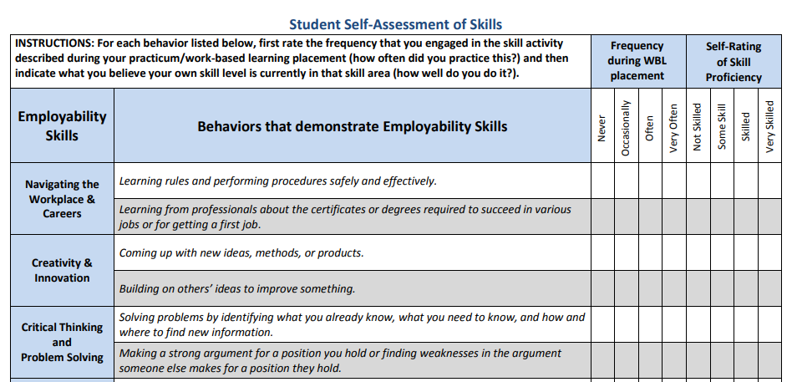
Likert Scale Example: Tennessee
Source: Tennessee Department of Education, n.d.
Notes:
Here is an example Likert scale from Tennessee. Here the student gives a rating on specific employability skills.

Slide 19
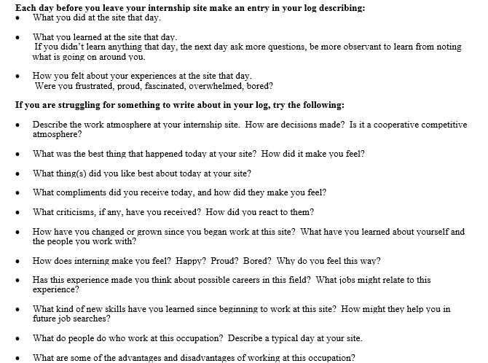
Self-Reflection Example: North Carolina
Source: North Carolina Public Schools, n.d.
Notes:
Here is an example of a self-reflection from North Carolina Public Schools. The reflection requires students to journal at the end of each day of their internship about what students did, what they learned, and how they felt during the experience. It includes additional reflection questions for the journal.

Slide 20
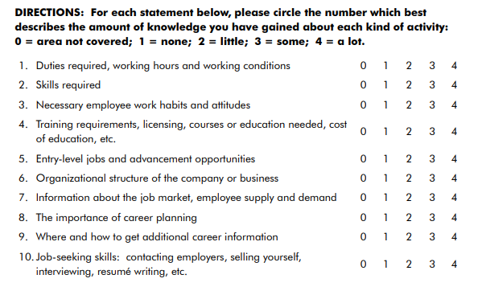
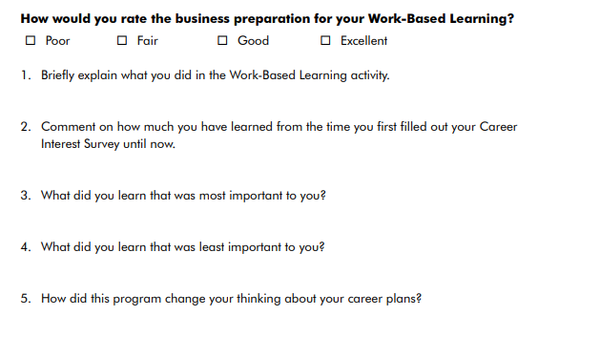
Hybrid Example: West Virginia
Source: West Virginia Department of Education, 2012, pp. 55–56
Notes:
This is a hybrid example from West Virginia. On the left side, students rate their performance on specific knowledge gained, and on the right, students write some reflections on a few open-ended questions. The questions ask things like “what did you learn that was most important to you” and “how did this program change your thinking about your career goals.”

Slide 21
Discussion: Selecting the Type of Self-Assessment
Refer to Handout 5, Decision Point 3.
In your team, discuss and rank the level of importance for each statement to help select the type of self-assessment that will best fit your local needs.
Capture your final decision on the handout.
Notes:
In your team, discuss and select which type of student self-assessment would work best for your state, district, or school. On the Decision Point 3 section of your Module 5 handouts, rank the level of importance for each statement to help select the type of self-assessment. Use the handout to capture your group’s final decision.

Slide 22
Decision Point 4: Define the Scales and Reflection Questions
Notes:
The next decision point is to define the scales and reflection questions.

Slide 23
Next Steps Based on Type of Self-Assessment
Type of Self-Assessment | Next Steps
Likert Scale | Define the self-assessment scales (Slides 24–26)
Reflection | Define reflection questions (Slides 27–31)
Hybrid | Define both the self-assessment scales and reflection questions (Slides 24–31)
Notes:
The next steps in this module depend on what type of student self-assessment you selected. If you’ve selected to use a Likert scale, the next step is to define the scales, which is discussed on Slides 24–26. For a reflection type self-assessment, the next step is to define the reflection questions, which is discussed on Slides 27–31. If you selected a hybrid self-assessment, then you’ll need to define both the self-assessment scales and reflection questions, which is covered on Slides 24–31.

Slide 24
Defining a Likert Scale
Quality
Short word or label to rate the level of performance
May not provide enough description to differentiate levels of performance
Simple and easy for students to use
Notes:
There are two approaches to define the scales of a Likert scale self-assessment. The first is to focus on quality. A quality Likert scale uses a short word or label to rate or describe the level of performance. The labels are typically simple and easy for students to use and understand. The focus of the Likert scale is on describing the quality of the performance. However, it may not provide enough description to differentiate levels of performance, particularly between the middle levels.

Slide 25
Defining a Likert Scale
Frequency
Rate the frequency or amount a skill or behavior occurs
May be easier for a student to reflect on the frequency as opposed to the quality
May provide less opportunity for students to reflect on the development of skills
May be a valid reason why a student did not demonstrate a skill or behavior frequently
Notes:
The second approach to defining the scales for a self-assessment is frequency. With this approach, the self-assessment is rating the frequency or amount a skill or behavior occurred during a work-based learning experience. The frequency may be easier for a student to reflect on compared with the quality. Students may have a better understanding of how often they were able to demonstrate particular skills as opposed to their quality. However, this may provide less opportunity for students to reflect on the development of skills. Capturing the frequency can highlight that there may be valid reasons why a student did not develop or demonstrate skills or behaviors because they did not have an opportunity to practice them frequently.

Slide 26
Likert Scale and Frequency Example: Tennessee
Source: Tennessee Department of Education, n.d.
Notes:
Tennessee’s student self-assessment uses both the quality and frequency approaches. Students rate their skill proficiency and the frequency during the work-based learning experience. This can provide additional data as to why a student may self-rate that they are not proficient in a particular skill because they did not have the opportunity to practice those skills.

Slide 27
Format of Reflection Questions
Journal
Completed throughout the work-based learning experience
Short Response
Typically completed at the end of the work-based learning experience
Specific questions for short-answer responses
Writing prompts and/or specific questions for essay responses
Notes:
For a self-reflection type of student self-assessment, two formats are commonly used. The first format is short response. This is typically completed at the end of the work-based learning experience. It includes specific questions for short-answer responses from the student. The second approach is a journal. This is completed throughout the work-based learning experience. The student writes responses to writing prompts or specific questions for essay responses. The journaling throughout the experience can help capture students’ reflection and how they’ve evolved over the course of the work-based learning experience. It may be useful for students to see how their own thinking has changed as well.

Slide 28




Topics for Reflection Questions
Skills, Behaviors, or Knowledge
Career Goals
Likes and Dislikes
Successes and Challenges
Notes:
There are four common topics for self-reflection questions. The first is focusing on skills, behaviors, or knowledge. These questions ask students to reflect on the development of identified skills, behaviors, or knowledge or broadly how students improved on career-related behaviors, skills, or knowledge. The second type of question connects the work-based learning experience or the skills to students’ career aspirations. The next type of reflection questions asks students to reflect on what they liked or disliked about the experience. The intent of this type of question is to have students reflect on what aspects of their future career they might like, such as types of job tasks or work environment. This give students the chance to reflect on the overall experience during their work-based learning experience. The final type of reflection question is geared toward the successes and challenges students experienced. This type of question can help students reflect on their strengths and areas of weakness and potentially brainstorm strategies to improve on identified challenges.

Slide 29
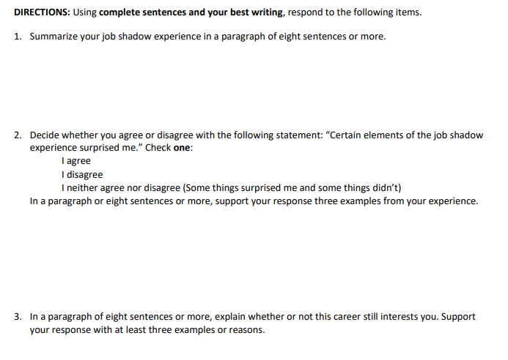
Reflection Handout Example: Nebraska
Source: Nebraska Department of Education, n.d.
Notes:
Here is an example of the reflection handout from Nebraska. Students respond in an essay format to guided reflection questions.

Slide 30
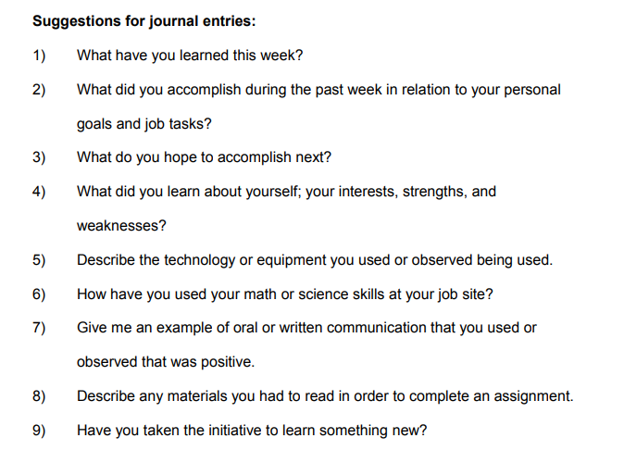
Journal Example: Charleston County School District
Source: Charleston County School District, n.d., p. 4
Notes:
Here is a journal example from Charleston County School District. It includes possible questions for students to reflect and write on in a journal. The questions ask what students did for tasks as well as how students have used certain skills such as mathematics or science during the work-based learning experience.

Slide 31
Key Considerations for Reflection Questions
Include sufficient number of questions to encourage reflection but not too many that it’s burdensome for students and educators.
Use clear language that cannot be misinterpreted.
Questions should address the depth of the experience as well as the overall experience.
Notes:
There are some key considerations when developing reflection questions. The language should be clear and concise so that students do not misinterpret the questions. Questions should address the depth of the experience as well as the overall experience. As you develop the questions, be sure there are a sufficient number of questions to encourage reflection but not too many questions that it is burdensome for students and educators.

Slide 32
Activity: Defining Scales and Reflection Questions
Refer to Handout 5, Decision Point 4.
In your teams, discuss and capture notes for defining the scales and reflection questions depending on the type of student self-assessment you selected.
Capture your final decision on the handout.
Notes:
Based on the type of self-assessment you selected, respond to the guiding questions in the Decision Point 4 section of the handouts. If you selected a hybrid self-assessment, complete both sets of guiding questions to define the scales and reflection questions.

Slide 33
Decision Point 5: Score the Self-Assessment
Notes:
The final decision point is to determine how to score the self-assessment.

Slide 34
Scoring Approaches
Weighted
Assign points or values to each rating or reflection question
Portfolio
One possible artifact within a larger portfolio
Notes:
There are two common scoring approaches. The first is within a portfolio. Student self-assessments can be one possible artifact included within a larger portfolio and scored using a rubric. The second approach is weighted. This approach assigns points or values to each rating within a self-assessment. For a self-reflection, you may assign a points value for each question.

Slide 35
Considerations for Portfolio Scoring
Portfolio
Self-assessments as stand-alone measures are not a valid and reliable measurement of skill development
Useful as one source of evidence to see how students perceive their own growth
Notes:
States and districts may choose the portfolio approach because self-assessments as stand-alone measures are not a valid and reliable measurement of skill development. However, they may provide additional context on skill development with additional artifacts within a portfolio. Self-assessments are useful as one source of evidence to see how the student perceives their own growth and development. For more information on developing portfolios and rubrics, please check out Modules 2 and 3.

Slide 36
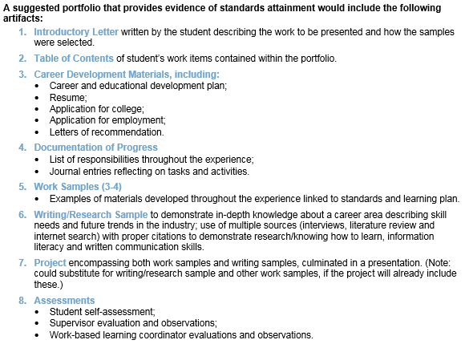
Portfolio Example: Ohio
Source: Ohio Department of Education, n.d.
Notes:
Here is a portfolio example from Ohio. This outlines the requirements for work-based learning portfolios. You can see that student self-assessments are one possible artifact under the eighth section of suggested artifacts.

Slide 37
Considerations for Weighted Scoring
Weighted
Award points that can translate into a grade or credit for work
Determine points value based on prioritizing skills or effort level for student to write responses
Notes:
Some considerations for the weighted approach is that it produces points that can translate into a grade or credit for work, particularly if using journaling or self-reflection. You can determine the points value based on prioritizing specific knowledge and skills or on the effort level for the student. For example, you may award more points for longer journal entries or the same point value for each reflection question completed.

Slide 38
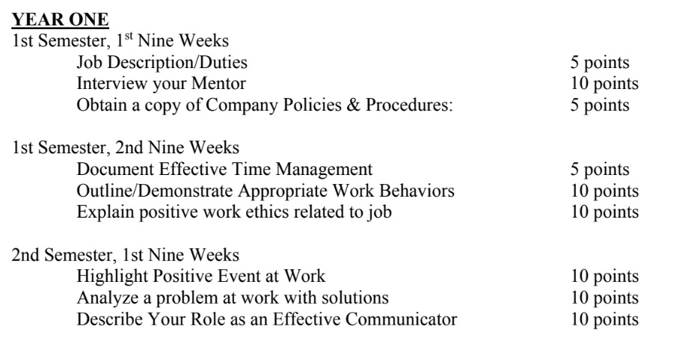
Weighted Example: Georgia
Source: Georgia Department of Education, 2016, p. 292
Notes:
Here is an example of the weighted approach from Georgia. Students are required to document and journal over the course of their work-based learning experience. Each journal prompt is weighted with a particular point value for its completion.

Slide 39
Discussion: Scoring Self-Assessments
Refer to Handout 5, Decision Point 5.
In your teams, discuss and capture notes for the best scoring approach that will fit your local context.
Capture your final decision on the handout.
If you selected quantitative, complete the additional guiding questions to determine the number of points.
Notes:
With your team, discuss and select which scoring approach will work best for your state, district, or school. Use the Decision Point 5 section of the Module 5 handouts to capture your notes, including which approach resonates, questions from the team, or any additional ideas. Use the handout to capture your final decision. If you selected portfolio, please review and complete Module 2. If you selected the weighted approach, discuss the additional guiding questions to determine how to award the number of points.

Slide 40
Wrap-Up

Slide 41
Decision Points
Determine the purpose for student self-assessment.
Define the knowledge and skills to assess.
Select the type of student self-assessment.
Define the scales and reflection questions.
Score the self-assessment.
Notes:
In this module, we discussed and finished five decision points to develop a work-based learning student self-assessment. The first decision point was to determine the purpose of the self-assessment. We then discussed defining the knowledge and skills to assess. The third decision point was to select the type of student self-assessment. Next, we defined the scales and reflection questions for the self-assessment. Finally, we determined how to score the self-assessment.

Slide 42
Work-Based Learning Module Series
Module 1: Selecting Appropriate Measures
Module 2: Developing Portfolios
Module 3: Designing Rubrics
Module 4: Constructing Employer Feedback and Evaluation
Module 5: Creating Student Self-Assessments
Notes:
This module is part of a five-part series on work-based learning measures. If you are considering using student self-assessments within a portfolio, we recommend that you also review Module 2 on portfolios and Module 3 on rubrics.

Slide 43
References
Brown, G.T. L., & Harris, L. R. (2013). Student self-assessment. In J. H. McMillian (Ed.), The SAGE handbook of research on classroom assessment (pp. 367–393). Thousand Oaks, CA: SAGE.
Charleston County School District. (n.d.). Work-based learning experience evaluation report. Charleston, SC: Author. Retrieved from http://charlestonempowered.com/wp-content/uploads/2014/08/WBL-Supervisor-Evaluation-Timesheet-and-Weekly-Journal-guidelines.pdf?_sm_au_=iMV4r6rJVVnPJ58q
Dunning, D., Heath, C., & Suls, J. M. (2004). Flawed self-assessment implications for health, education, and the workplace. Psychological Science in the Public Interest, 5(3), 69–106.
Georgia Department of Education. (2016). Work-based learning: Including standards and activities for career-related education. Atlanta, GA: Author. Retrieved from https://www.dropbox.com/sh/b7cmfmg86wk2575/AABojjezjoodzGBJWFbIa2sfa?dl=0&preview=Complete+WBL+Manual_Printing+Caution_+Over+200+pages.pdf
Nebraska Department of Education. (n.d.). Job shadow reflection form. Lincoln, NE: Author. Retrieved from https://cdn.education.ne.gov/wp-content/uploads/2018/08/Job-Shadow-Reflection-Form.pdf

Slide 44
References
North Carolina Public Schools. (n.d.). Journal Academic Internship Program. Raleigh, NC: Author. Retrieved from http://www.ncpublicschools.org/docs/cte/curriculum/work-based/credit/journal-academic-internship-program.doc
Ohio Department of Education. (n.d.). Student skills assessment rubric. Columbus, OH: Author. Retrieved from http://education.ohio.gov/getattachment/Topics/Career-Tech/Career-Connections/Work-Based-Learning/Work-Based-Learning-for-Students-and-Familes/StudentSkillsAssessmentRubric.docx.aspx
Tennessee Department of Education. (n.d.). Student self-assessment of skills. Nashville, TN: Author. Retrieved from https://www.tn.gov/content/dam/tn/education/ccte/wbl/wbl_wbl_student_self_assessment_of_skills.pdf
West Virginia Department of Education. (2012). Experiential learning guide. Charleston, WV: Author. Retrieved from https://wvde.state.wv.us/hstw/documents/ExperientialLearningGuide_2013.pdf

Slide 45
1000 Thomas Jefferson Street NW
Washington, DC 20007
800-634-0503
www.ccrscenter.org | ccrscenter@air.org
This work was originally produced in whole or in part by the College and Career Readiness and Success Center with funds from the U.S. Department of Education under cooperative agreement number S283B120034. The content does not necessarily reflect the position or policy of the Department of Education, nor does mention or visual representation of trade names, commercial products, or organizations imply endorsement by the federal government.
Copyright © 2019 American Institutes for Research. All rights reserved.

