Slide 1

Module 4: Constructing Employer Feedback and Evaluation
Work-Based Learning Measures Series
  [Insert Name]
    [Insert Position]
      Month 20XX – Arial, 16 pt, White
Notes:
Thank you for visiting the College and Career Readiness and Success Center’s (CCRS Center’s) series Work-Based Learning Measures. You are in Module 4: Constructing Employer Feedback and Evaluation. This module will outline the key decisions to develop employer feedback and evaluation to assess student learning from work-based learning.

Slide 2
Work-Based Learning Module Series
Module 1: Selecting Appropriate Measures
Module 2: Developing Portfolios
Module 3: Designing Rubrics
Module 4: Constructing Employer Feedback and Evaluation
Module 5: Creating Student Self-Assessments
Notes:
This module is part of a five-part series. We recommend that you first review Module 1: Selecting Appropriate Measures before continuing in this module. The first module provides an overview of the various types of measures and outlines decision points needed to select which type of measure will best fit your local context and needs. Module 2 focuses on the decision points to develop portfolios, and Module 3 shares the decision points needed to design a rubric. Module 5 outlines the decision points to create a student self-assessment. This module, Module 4, digs deep into the decision points needed to develop employer feedback to assess work-based learning.

Slide 3
Objectives
Explore employer feedback as a possible measure of work-based learning.
Discuss the key decisions in constructing employer feedback to assess work-based learning experiences.
Notes:
Our objective for this module is to help you understand how employer feedback can assess students’ work-based learning experiences. In addition, we’ll discuss and carry out the key decisions needed to develop employer feedback.

Slide 4
Overview of Employer Feedback
Notes:
Why is it important to measure student learning from work-based learning?

Slide 5


Measures of Work-Based Learning
States reviewed: 17
Districts reviewed: 59
Total resources reviewed: 109
Employer evaluations: 30
Rubrics: 23
Self-assessments/ reflections: 19
Worklogs: 7
Portfolios: 5
Notes:
To learn how states and districts measure work-based learning, the College and Career Readiness and Success Center (CCRS Center) conducted a document scan collecting and analyzing work-based learning measures. States selected included leaders in work-based learning and those that specified in their state Every Student Succeeds Act (ESSA) plans that they plan to use work-based learning as an indicator of career readiness in their state accountability. We also collected documents from the largest two to four districts in each state. In addition to the measures, we collected related work-based learning resources such as guidebooks and presentations that often include the context on how to implement the measure. We searched for resources publicly available on state or district websites and found a total of 109 work-based learning measures and resources. This included 30 employer evaluations, 23 rubrics, 19 self-assessments or self-reflections, seven worklogs, and five portfolios. The information and decision points were developed based on an analysis of the document scan and a literature scan on each type of measure.

Slide 6
What Can Employer Feedback Do?
Collect employer’s perspective on the knowledge and skills students gain.
Encourage employers to provide students with feedback on their performance.
Model the employer evaluation and feedback process within the real world.
Evaluate work-based learning program quality.
Notes:
Employer feedback is completed by the employer to document and assess the student’s performance during the experience or the development of his or her skills and knowledge. Employer feedback typically assesses students’ knowledge and skills or the accomplishment of a goal or task. This could include employability or technical skills and setting a goal that is focused on developing specific skills or completing a task.
Employer feedback allows you to collect the employer’s perspective on the knowledge and skills that students develop over the course of their work-based learning experience. The process of completing an employer feedback form can encourage employers to provide students with feedback on their performance, development of knowledge and skills, and suggestions for how students can further develop to meet career goals. In addition, this process can model the employer evaluation and feedback process that often occurs in the real world. Employer feedback could also be used to assess program quality and implementation for work-based learning. For example, you could ask the employer to evaluate to what extent the school provided support and coordination during the work-based learning experience. This could be a way to collect data to make improvements to the program’s quality, improve student and employer match-ups, or identify additional supports needed for employers and students.

Slide 7
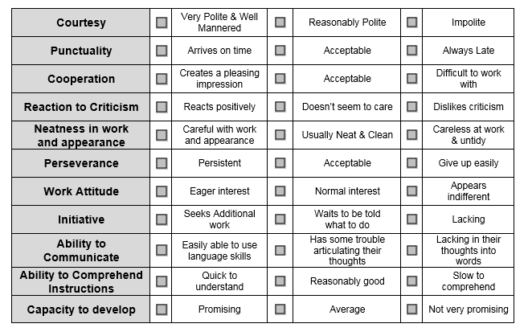
Example: California
Source: California Department of Education, n.d.
Notes:
Here is an example of an employer feedback rubric from California. The employer rates the student’s performance on certain employability skills and work-related attitudes.

Slide 8
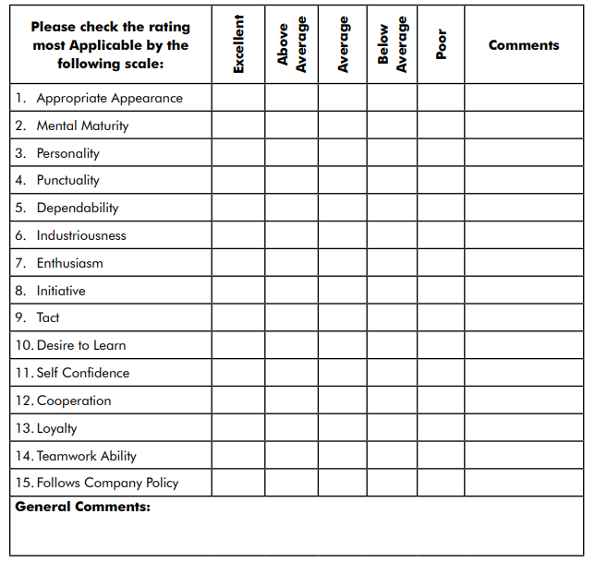
Example: West Virginia
Source: West Virginia Department of Education, 2012, p. 62
Notes:
Here is an example of an employer feedback form from West Virginia. It assesses mental maturity, dependability, appropriate appearance, and cooperation.

Slide 9
Decision Points
Determine the purpose for employer feedback.
Define the knowledge and skills.
Select the type of employer feedback.
Define the scales, goals, or reflection questions.
Determine how to score employer feedback.
Notes:
We will discuss five decision points in this module. The first is to determine the purpose for employer feedback, and we’ll connect that back to the goals for measuring work-based learning that were discussed in Module 1. The second is to define the knowledge and skills to assess within the employer feedback. The next decision point is to select the type of employer feedback. Next, we’ll define the scales, goals, or reflection questions within the employer feedback. The final decision point is to determine how to score employer feedback.

Slide 10
Decision Point 1: Determine the Purpose for Employer Feedback
Notes:
The first decision point in developing employer feedback is to determine the purpose.

Slide 11
Purposes for Employer Feedback
Student Progress: Evaluating individual student progress, grading, or certifying an accomplishment
Instructional: Diagnosing students’ needs, informing instructional planning, or improving instructional effectiveness
Program Quality: Collecting feedback on school coordination and support to employers
Notes:
There are three common employer feedback purposes: student progress, instructional, and program quality. If your purpose for employer feedback is student progress, then your goal is to evaluate individual student progress, grading, or certifying an accomplishment. Another purpose is instructional, which helps to diagnose students’ needs, inform instructional planning, or improve instructional effectiveness. Schools could use the feedback from employers to inform instruction outside of the work-based learning experience or to identify areas of needs for students to provide supplemental supports in the classroom. A third potential purpose is for program quality. Collecting feedback and data from employers could be used to improve the quality of work-based learning programs. Schools could collect feedback on the quality of the coordination with the employers, additional supports employers may need, or any other recommendation to help better prepare students prior to entering the job site. Program quality provides school with data on how to improve the implementation of work-based learning beyond instructional planning. It is possible that you may have multiple purposes for using employer feedback, but it may be helpful to prioritize these purposes as you develop your measure.

Slide 12
Discussion: Purpose of Employer Feedback
Refer to Handout 4, Decision Point 1.
In your teams, discuss and complete the checklist for employer feedback purpose(s) that best fits your state, district, or school.
Capture your final decision on the handout.
Notes:
In your teams, discuss and capture which purpose for using employer feedback would be the best fit with your state, district, or school goals. Discuss and complete the checklist in Handout 4, Decision Point 1, to help determine your purpose(s). Capture your final decisions on the handout.

Slide 13
Decision Point 2: Define the Knowledge and Skills
Notes:
The next decision point in creating employer feedback is to define the knowledge and skills to assess. This addresses what is measured with the employer feedback.

Slide 14
Types of Knowledge and Skills
Academic Knowledge
Foundational subject matter knowledge
Technical Knowledge and Skills
Skills needed for specific occupations, industries, or careers
Employability Skills
General skills and knowledge necessary for all employment levels and in all sectors
Notes:
Your employer feedback could be based on the same knowledge and skills that were discussed in Module 1. Employers are well positioned to give feedback and assess students’ development of technical skills because they are familiar with the specific skills needed in their industry. In addition, employers will be able to observe students’ employability skills. For example, employers can assess the quality of students’ professionalism, customer service skills, and their willingness to learn.

Slide 15




Approaches to Defining Knowledge and Skills
In-Person Meeting
Survey or Focus Groups
Review and Comment
Adopt National or Existing Framework
Notes:
As described in Module 1, collecting stakeholder feedback is an excellent approach to help define the knowledge and skills for collecting employer feedback. As you work with stakeholders to determine which types of knowledge and skills should be measured, you can work with this group further to get feedback on describing the skills within the employer feedback form. You can collect stakeholder feedback from educators such as career and technical education (CTE) teachers, counselors, work-based learning coordinators, administrators, and representatives from business and industry. To collect their feedback, you could convene in-person meetings to work together to define the knowledge and skills, conduct a survey or focus group to gather their insights on the most critical skills, or have stakeholders review and comment on drafts of the employer feedback forms.
Another approach to help define the knowledge and skills is to adopt or modify a national or existing framework. This approach is particularly helpful for employability skills or technical skills. The Employability Skills Framework is an example of a national framework that states or districts could use to assess from work-based learning experiences. In addition, industries or local employers may have existing lists that outline the types of skills and knowledge that they require from their employees that schools could adopt. These lists, particularly for any technical skills, may need to be modified so that they are attainable for students.

Slide 16
Considerations for Defining Skills
Describes development of knowledge and skills at the student level.
Description of skills is written concisely for employers and students to understand.
Notes:
There are a couple of key considerations for defining knowledge and skills for employer feedback. The first is what it looks like for a student to demonstrate each knowledge and skill during a work-based learning experience. Employers will need clear descriptions of what the skills, knowledge, and results should look like at the student level. The knowledge and skills may need to be scaffolded to the student level, and employers may need support adjusting from evaluating these skills for adults. How do you describe each skill in a concise and clear way so that students and employers comprehend?

Slide 17
Discussion: Defining Knowledge and Skills
Refer to Handout 4, Decision Point 2.
In your teams, discuss the guiding questions to define your knowledge and skills for the employer feedback.
Capture your final decision on the handout.
Notes:
To define the knowledge, skills, and results, first refer to the list of knowledge and skills developed in Module 1 or the Skills Bank handout. In your team, brainstorm and discuss the guiding questions in the table in the Decision Point 2 section of the handout. Then use the second table in the handout to develop a stakeholder outreach plan to finalize the list of knowledge and skills that will be measured in your employer feedback.

Slide 18
Decision Point 3: Select the Type of Employer Feedback
Notes:
The next decision point is to select the type of employer feedback.

Slide 19
Types of Employer Feedback
Rubric: Describes skills across performance levels
Likert Scale: Rates quality of performance
Reflection: Responds to open-ended reflection questions
Results: Based on completion of goal or task
Notes:
There are four types of employer feedback. The first is a rubric, which describes the knowledge and skills across multiple performance levels. This type of employer feedback provides employers and students with greater description on what each of the knowledge and skills look like and the progression of growth. However, this type of employer feedback may require more training and resources for students and employers to use with fidelity. Employers may be less familiar with using a rubric compared with educators, may need additional training on understanding the knowledge and skills in the rubric, and training on how to score the rubric.
The next type of employer feedback is the Likert scale. This type of employer feedback lists the various knowledge and skills for employers to assess and then asks them to give a rating across a Likert scale. Compared with a rubric, this type of employer feedback may be easier for employers to understand and use because the Likert scale ratings are often more familiar than a rubric. However, this type of measure may be less reliable because it does not provide a detailed description of what the quality of performance for each skill looks like across the scale.
The next type of employer feedback is reflection, which includes open-ended questions for employers to respond. These questions could give employers additional opportunities to describe the student’s performance over the work-based learning experience, give feedback to the student on how to improve, or provide strategies and suggestions for the student to continue learning in this field. Schools may want to include reflection questions to improve program quality as well. The reflection question could provide data on how to improve the work-based learning program, such as coordination with the school.
The last type of employer feedback is results based. The employer and student establish a goal or objective for the student to be assessed on. This goal could be focused on developing particular skills or the completion of a task. This type of employer feedback models the evaluation process often used in the real world by many companies. However, employers and students will need guidance on how to establish a rigorous but attainable goal.

Slide 20
Rubric Example: California
Source: California Department of Education, n.d.
Notes:
Here is an example of employer feedback via a rubric. Students are assessed on a common set of employability skills and work-related attitudes. The rubric then describes what each skill looks like across three performance levels. This employer feedback rubric uses concise descriptions of the quality of each skill, and each skill has a unique description.

Slide 21
Likert Scale Example: West Virginia
Source: West Virginia Department of Education, 2012, p. 62
Notes:
Here is an example of a Likert scale from West Virginia. It includes a list of employability skills and work-related attitudes, and then the employer is to rate the student performance from “excellent” to “poor.” The same Likert scale is used to describe the quality of performance across all the skills, and the labels are not defined.

Slide 22
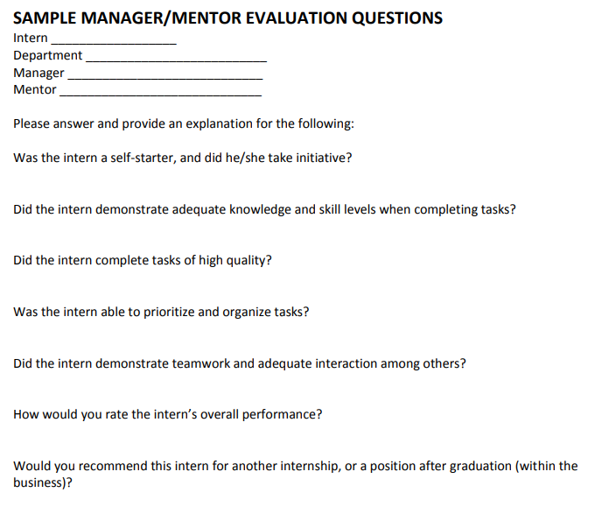
Reflection Example: Nebraska
Source: Nebraska Department of Education, n.d., p. 22
Notes:
Here is an example of employer reflection questions from Nebraska. Some of the questions focus on skill development and the completion of tasks on time and with quality. In addition, the reflection questions allow the employer to rate the student’s overall performance and potentially recommend the student for future positions or internships.

Slide 23
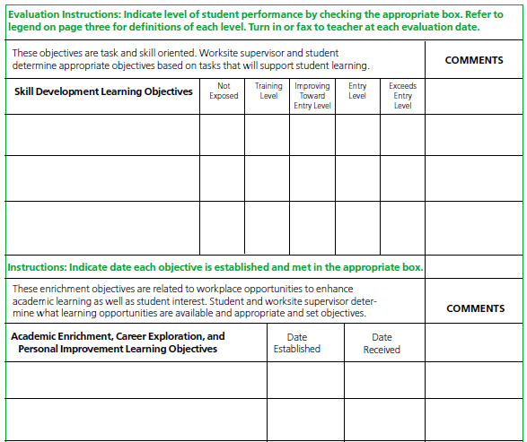
Results-Based Example: Kansas City
Source: Kansas City Schools, 2002, p. 190
Notes:
Here is an example of a results-based employer feedback from Kansas City. On the top half, the student and the employer set skill development learning objectives, and then the employer rates how the student met the objectives. In addition, on the bottom half of the form, the student sets academic enrichment or career exploration learning objectives.

Slide 24
Factors of Implementation Success
 | Rubric | Likert Scale | Reflection | Results
Training and Resources | High | Medium | Low | High
Calibration | High | Low | Low | High
Communication | High | Medium | Medium | High
Notes:
It is important to consider your implementation capacity when selecting the type of employer feedback. In Module 1, we discussed the four factors of implementation success to consider when selecting a work-based learning measure. Three of those same factors are helpful to consider when selecting the type of employer feedback. This table illustrates the level of intensity needed for each type of employer feedback by each implementation success factor. The rubric type of employer feedback requires a higher level of intensity for the majority of the factors compared with the reflection type of employer feedback.
A rubric employer feedback will require training and resources to help employers, educators, and students understand the knowledge and skills described within the rubric. In addition, employers will need support on scoring and greater calibration needs if you want comparable results across students and different types of work-based learning experiences. This type of employer feedback will require greater coordination and communication with employers.
A Likert scale employer feedback will require some training and resources for employers to understand the knowledge and skills. However, the structure of a Likert scale will likely be more familiar to employers and intuitive to use. Calibration will be less complicated than a rubric because the Likert scale helps to determine the scoring. This more intuitive format will require less communication and coordination with employers than a rubric.
Reflection questions requires less capacity to implement such as training and resources and calibration. It will still require some communication with employers to respond to the reflection questions. However, a reflection-style employer feedback on its own is a not a rigorous measure of student learning from a work-based learning experience. It will not provide comparable data across students. It may be an excellent way to collect data for program quality or to serve as one artifact within a portfolio.
A results employer feedback requires a high intensity of capacity for each of the implementation indicators. Employers, educators, and students will need training and resources on how to develop a rigorous but attainable goal for students. If the goal is skill based, then additional training and knowledge building will be needed to understand the knowledge and skills to assess. Calibration may be complicated because all stakeholders will need support on how to determine scores consistently across different goals for different students. Development of a rigorous but attainable goal will require communication and coordination with employers.

Slide 25
Activity: Selecting the Type of Employer Feedback
Refer to Handout 4, Decision Point 3.
In your teams, discuss and rank the level of importance for each statement to help select the type of employer feedback.
Capture your final decision on the handout.
Notes:
In your teams, discuss and rank the level of importance for each statement to help select the type of employer feedback that will best fit your local needs. Capture your final decisions on the handout.

Slide 26
Decision Point 4: Define the Scales, Goals, or Reflection Questions
Notes:
The next decision point is to define the employer feedback scales, goals, or reflection questions.

Slide 27
Next Steps Based on Type of Rubric
Type of Employer Feedback | Next Steps
Rubric | Refer to Module 3: Designing Rubrics
Likert Scale | Define the employer feedback scales (Slides 28–29)
Results | Define the goals on slides (Slides 30–34)
Reflections | Define the reflection questions (Slides 35–36)
Notes:
The next steps in this module depend on what type of employer feedback you selected. If you’ve selected to use a rubric to collect employer feedback, please refer to Module 3, which outlines the decision points for developing a rubric. For a Likert scale type of employer feedback, the next step is to define the scales, which is discussed on Slides 28–29. For a results type of employer feedback, the next step is to define the goals, which is discussed on Slides 30–34. Finally, for a reflections type of employer feedback, the next step is to define the reflection questions, which is covered on Slides 35–36.

Slide 28
Defining a Likert Scale
Likert Scale
Short word, number, or label to rate the level of performance
May not provide enough description to differentiate levels of performance
Simple and easy for employers to use
Number of scales to differentiate performance
Notes:
If you selected a Likert scale employer feedback, you will need to define the Likert scale. This includes selecting a short word or label that describes the level of performance for the knowledge or skill. It is important that the label is simple and easy for employers to understand. Depending on the knowledge and skills evaluated, a label alone may not provide enough description to differentiate levels of performance. If greater detail is needed, you may need to consider developing a rubric that will describe the traits and behaviors across the performance levels. In addition, you will need to consider how many scales to include. It is important that the employer feedback has a sufficient number of scales to capture student progress and growth but not so many performance levels that it becomes difficult to differentiate performance, particularly in the middle levels.

Slide 29
Examples of State and District Likert Scales
State(s) or District | Number | Likert Scale Labels
Charleston County School District | 3 | Skilled, Moderately Skilled, and Limited Skilled
Chicago Public Schools | 3 and 4 | Exceeds Expectation, Meets Expectation, Below Expectation, and Strongly Agree, Agree, Neither Agree Nor Disagree, Disagree, and Strongly Disagree
Georgia | 5 | Excellent, Above Average, Average, Below Average, Unsatisfactory
Kansas City Schools | 5 | Exceeds Entry Level, Entry Level, Improving Toward Entry Level, Training Level, Not Exposed
Kentucky | 5 | Excellent, Good, Average, Needs Improvement, and Poor
North Carolina | 5 | Superior, Above Standard, At Standard, Below Standard, Unsatisfactory
South Carolina | 5 | Excellent, Good, Fair, Poor, and Unacceptable
West Virginia | 5 | Excellent, Above Average, Average, Below Average, and Poor
Notes:
This table outlines the Likert scales from the CCRS Center’s document scan. The majority of states and districts have three to five performance levels. The common Likert scale labels describe quality such as excellent, good, fair, and poor. Others address the level of being skilled such as in Charleston County School District or meeting expectations as in Chicago Public Schools.

Slide 30
Considerations for Developing Goals
Determine who will lead the development of the goal.
Provide guidance and training to employers, students, and educators on how to set goals that are measurable and achievable.
Develop guidelines and guidance for employers, students, or educators on establishing goals.
Notes:
If you selected a results-based employer feedback, there are several considerations to help you define the results. One is to ensure that students lead the goal development with support from adults such as teachers, counselors, or employers. The student and employer may want to base the goal on a task or skill that is aligned to the student’s interests, career goals, or strengths and weaknesses. This will help prioritize the goal for the student while remaining relevant to the work-based learning experience. It is important that the goal is measurable and something that is achievable during the course of the work-based learning experience. You may need to create guidance to support both students and employers with developing appropriate goals. Identify tasks or skills that align to the student’s interests, career goals, or strengths and weaknesses.

Slide 31
Approaches to Defining Goals
Task Based
Determined by employer and student based on tasks, responsibilities, or other career development objectives.
Skill Based
Establish a goal focused on practicing or developing a particular skill.
Notes:
There are two approaches to defining goals: task based and skill based. A task-based approach allows the student and employer to define the goal or learning objective based on the tasks, responsibilities, or other career development objectives. The skill-based approach is establishing a goal focused on practicing or developing a particular skill.

Slide 32
Example: Kansas City
Skill-Based Goal
Source: Kansas City Schools, 2002, p. 190
Notes:
The Kansas City example of a result-based employer evaluation includes a skill-based goal. The top half is a skill-based goal in which the student and worksite supervisor determine appropriate skill development learning objectives and then the employer rates the student’s performance.

Slide 33
Considerations for Task-Based Goals
Task Based
Goals may be job or career specific
May be easier for employers to assess because focus is on the completion of tasks
Does not explicitly assess the development of career-readiness skills and knowledge
Notes:
Some key considerations for developing task-based goals are that they can be job or career specific. This allows the student to potentially focus on developing career-specific knowledge and skills. This type of goal may be easier for an employer to assess because the goal is based on the completion of tasks. However, this type of goal does not explicitly assess the development of career-readiness skills and knowledge.
An example of a task-based goal could be a student interning with a group that plans events and the student is responsible for photographing the events. The student and employer might have a goal that the student takes 50 high-quality photos at three different events over the course of the internship. This goal would be timebound, measurable, and connected to the student’s responsibilities.

Slide 34
Approaches to Defining Goals
Skill Based
Explicitly measures the development of career-readiness skills
May be more difficult for employers to determine specific skill growth or development
May require additional training and support to employers on developing, monitoring, and scoring this type of goal
Notes:
Skill-based goals, on the other hand, measure the development of career-readiness skills. These could be employability skills or technical skills that are career or job specific. It may be more challenging for the student and employer to develop this type of goal because it is not based on the completion of tasks but on the development of skills. Employers and students may need more guidance on how to craft rigorous skill-based goals that are attainable and measurable.
Thinking back to our photography example, the student and employer may determine that an appropriate skill for the student to develop is focusing on moving subjects. The skill-based goal might be to have clients select 20% more photographs of moving subjects from the first event to the third event. This would demonstrate that the photographs are improving over the course of the internship and events if clients select to purchase more moving subject photos for their events.

Slide 35
Considerations for Defining Reflection Questions
Write questions that can provide context on student performance beyond skills, behaviors, traits, or results.
Give employers opportunities to describe students’ overall performance.
Include questions for employers to provide students feedback on how to improve their performance or skills.
Ask employers for feedback or suggestions on how to improve programs, particularly coordination with schools.
Notes:
To define the reflection questions, it may be helpful to consider questions that can add additional context on the student’s performance beyond knowledge, skills, and results. For example, are there particular circumstances that may explain the student’s level of performance? Is there additional career- or industry-specific feedback that may be useful for an employer to share with the student? The reflection questions allow employers to describe the overall performance. The student, school, and teachers may receive additional information and feedback on the student’s performance beyond a simple rating. The reflection questions can provide employers an opportunity to share ways the student can improve their skills or performance or future tips if the student is interested in the same career field.

Slide 36
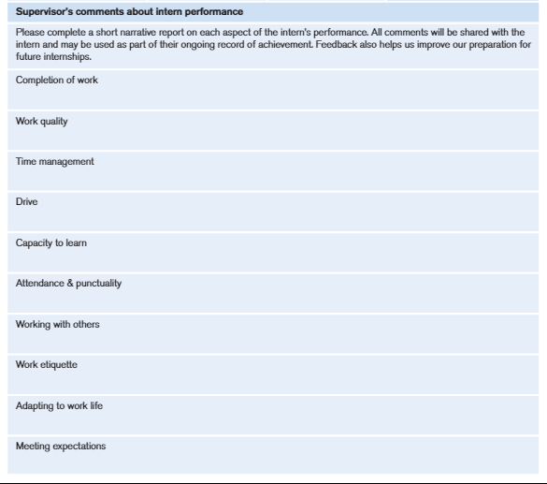
Example: Career Academies
Source: Career Academies, 2011, p. 34
Notes:
Here is another example from the Career Academies in California, which asks the employer to give feedback on various aspects of the student’s work such as work quality, time management, working with others, and capacity to learn.

Slide 37
Activity: Defining Scales, Goals, or Reflection Questions
Refer to Handout 4, Decision Point 4.
In your teams, discuss and capture notes for defining scales, goals, or reflections depending on the type of employer feedback you selected.
Capture your final decision on the handout.
Notes:
Based on the type of employer feedback you select, discuss and complete the corresponding guiding questions in the Handout 4, Decision Point 4, section of the handout. If you are doing a Likert scale employer feedback, complete the section on Defining Likert Scales. If you are doing a results-based employer feedback, complete the Define Goals section of the handout. If you are including reflection questions in your employer feedback, complete the Employer Reflection Questions section of the handout to help draft your employer feedback questions.

Slide 38
Decision Point 5: Determine How to Score Employer Feedback
Notes:
The last decision point is to determine how to score the evaluation.

Slide 39
Scoring Approaches
Weighted
Assign points or values to each rating
Qualitative
Describe the level of performance or growth
Portfolio
Serves as an artifact within a larger portfolio
Notes:
There are three common scoring approaches to employer feedback: weighted, qualitative, and portfolio. The weighted approach is assigning points or a value to each rating or performance level. The qualitative approach describes the level of performance or growth. An employer feedback could serve as an artifact within a larger portfolio. With this approach, other artifacts in addition to the employer feedback are reviewed and scored holistically with a rubric.

Slide 40
Considerations for Weighted Scoring
Weighted
Produces quantitative data that the school, district, or state can track for continuous improvement efforts
Scores can easily translate into a grade
Notes:
There are some key considerations to using the weighted approach for scoring employer feedback. This approach produces numeric or quantitative data that the school, district, or state can track and use for continuous improvement efforts. If your goal for measuring work-based learning is to use data to improve the quality of work-based learning for all students, this type of measure and scoring approach can provide that type of data. In addition, the numeric scores can translate into a grade. However, it may encourage employers and students to focus on the rating rather than helping the students develop and grow particular skills or knowledge. For a results-based employer feedback in which the student is setting a goal, you may have the employers rate the students’ ability to meet the established goal. The rating could similarly be weighted as a Likert scale employer evaluation.

Slide 41
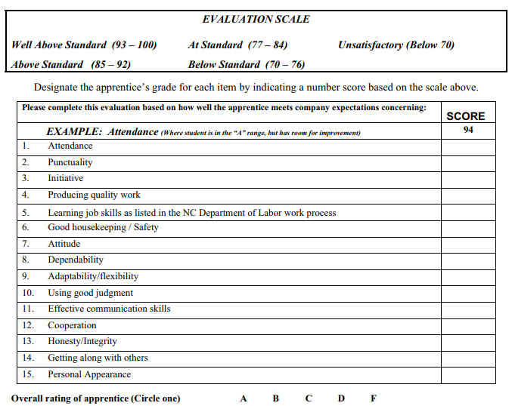
Weighted Example: Charlotte-Mecklenburg Schools
Source: Charlotte-Mecklenburg Schools, n.d.
Notes:
Here is an example of an employer evaluation that is scored using the weighted approach from Charlotte-Mecklenburg Schools. Each rating or performance level is assigned a percentage range that can connect to a grade. The form provides an example for “attendance,” which is scored at 94% or “well above standard.”

Slide 42
Considerations for Qualitative Scoring
Qualitative
Does not provide quantifiable data
Focuses on the description of performance and growth
May encourage employers and students to focus on how students can develop and grow skills
Data can be difficult to track or monitor
Notes:
There are some key considerations to using the qualitative approach for scoring employer feedback. This approach does not provide quantifiable data that is easy to track or monitor. If one of your objectives to measuring work-based learning is to gather data for continuous improvement, this approach may not support that goal. This approach focuses on the description of performance and growth. This encourages both employers and students to focus on developing and growing the student’s skills and knowledge.

Slide 43
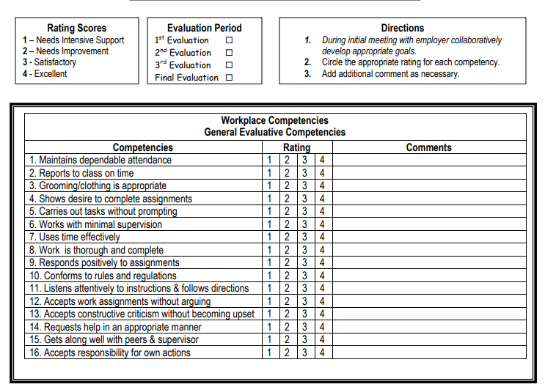
Qualitative Example: Los Angeles Unified
Source: Los Angeles Unified School District, n.d.
Notes:
Here is an example of a qualitative scoring approach from Los Angeles. Each skill is given a rating, such as from “needs intensive support” to “excellent.” It also includes space for the employer to give comments on each competency. The rating includes a numeric ranking but it doesn’t assign a points value, percentage, or grade level.

Slide 44
Considerations for Portfolio Scoring
Portfolio
Serves as one artifact within a portfolio
Provides a more comprehensive understanding of student skills from multiple perspectives
Provides a balance on focusing on student development while giving data for graduation or accountability purposes
Notes:
There are some considerations for using the portfolio approach to score employer feedback. The employer feedback would be one artifact among many scored within the portfolio. This means that several perspectives or sources of evidence will be used to assess the student’s performance. This approach provides a more comprehensive understanding of the knowledge and skills students develop over their work-based learning experience because it includes multiple sources of evidence. This approach provides a balance of focusing on student development and growth while still providing the data needed for accountability goals. Refer to Module 2: Developing Portfolios for the decision points needed to develop work-based learning portfolios.

Slide 45
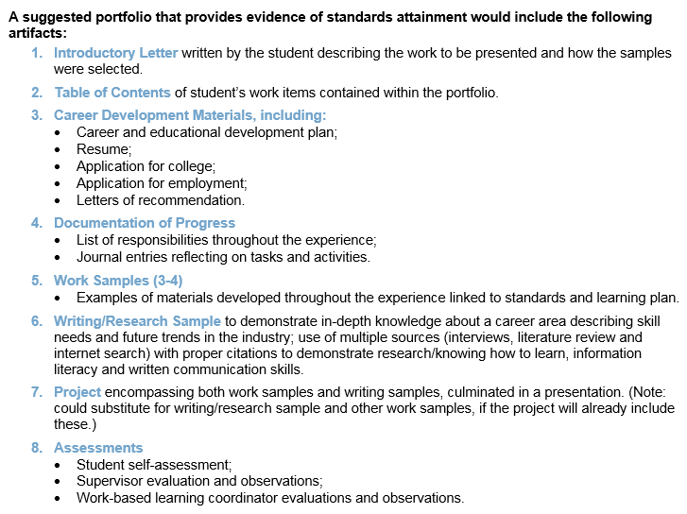
Portfolio Requirements: Ohio
Source: Ohio Department of Education, 2016
Notes:
Here is an example from Ohio of the suggested components for a work-based learning portfolio. You can see that employer or supervisor evaluation and observations are one possible artifact for the portfolio.

Slide 46
Discussion: Scoring Employer Feedback
Refer to Handout 4, Decision Point 5.
In your teams, discuss and capture notes for the scoring approach that best fits your state, district, or school.
Capture your final decision on the handout.
Notes:
In your team, discuss and determine which scoring approach will work best for your state, district, or school. Use the Decision Point 5 section of the handouts to capture your notes and final decision. The handouts include additional guidance to develop a weighted approach.

Slide 47
Wrap-Up

Slide 48
Decision Points
Determine the purpose for employer feedback.
Define the knowledge and skills.
Select the type of employer feedback.
Define the scales, goals, or reflection questions.
Determine how to score employer feedback.
Notes:
Throughout this module, we discussed and completed five key decision points to help develop employer feedback to assess work-based learning. First, we determined the purpose for employer feedback and connected it back to your goals for measuring work-based learning. The next decision point was to define the knowledge, skills, or results to assess with the employer feedback. We then selected the type of employer feedback and defined the scales, goals, or reflection questions. Finally, we determined how to score employer feedback.

Slide 49
Work-Based Learning Module Series
Module 1: Selecting Appropriate Measures
Module 2: Developing Portfolios
Module 3: Designing Rubrics
Module 4: Constructing Employer Feedback and Evaluation
Module 5: Creating Student Self-Assessments
Notes:
This module is part of a five-part series, and you just completed Module 4: Constructing Employer Feedback and Evaluation. The first module provided an overview on selecting appropriate work-based learning measures. The other modules provide an overview on the decision points to develop other types of work-based learning measures such as rubrics, portfolios, and student self-assessments. If you are using employer feedback as an artifact within a portfolio, we recommend that you review Module 2.

Slide 50
References
California Department of Education. (n.d.). Work experience education guide. Sacramento, CA: Author. Retrieved from https://www.google.com/url?q=https://www.cde.ca.gov/ci/ct/we/documents/weeguide.doc&sa=U&ved=0ahUKEwiYlcOhhJLaAhWyV98KHUFMAs8QFggEMAA&client=internal-uds-cse&cx=007899273231353282595:rooj8qfkg0k&usg=AOvVaw3KMFGR16rXTljCm9nn0WLB
Career Academies. (2001). Internship logbook for students. London, UK: Author. Retrieved from https://connectedstudios.org/url-zv1qgafyIA8wS2PgheFAG6KwcUgA0d3fFO8Gc1gJ
Charlotte-Mecklenburg Schools. (n.d.). Employer’s evaluation of apprentice. Charlotte, NC: Author. Retrieved from http://www.ncpublicschools.org/docs/cte/work-based/credit/employer-eval-apprentice.pdf
Kansas City Schools. (2002). Quality work-based learning toolkit. Kansas City, MO: Author. Retrieved from https://connectedstudios.org/url-zv1qgafyIA8wS2PgheFAG6KwcUgA0d3fFO8FeFgJ?_sm_au_=iMVkRQPr4611sTk0
Los Angeles Unified School District. (n.d.) Work-based learning competencies. Los Angeles, CA: Author. Retrieved from https://achieve.lausd.net/cms/lib08/CA01000043/Centricity/domain/220/dots/Work-Based_Competencies_Evaluation.pdf?_sm_au_=iMVkRQPr4611sTk0

Slide 51
References
Nebraska Department of Education. (n.d.). Employer’s guidebook to developing a successful internship program. Lincoln, NE: Author. Retrieved from http://opportunity.nebraska.gov/files/businessdevelopment/internne/Employer's%20Guidebook%20to%20Developing%20a%20Successful%20Internship%20Program.pdf
Ohio Department of Education. (2016). Work-based learning student reflection questions. Columbus, OH: Author. Retrieved from http://education.ohio.gov/getattachment/Topics/Career-Tech/Career-Connections/Work-Based-Learning/Work-Based-Learning-for-Students-and-Familes/Student-Reflection-Questions.docx.aspx
West Virginia Department of Education. (2012). Experiential learning guide. Charleston, WV: Author. Retrieved from https://wvde.state.wv.us/hstw/documents/ExperientialLearningGuide_2013.pdf

Slide 52
1000 Thomas Jefferson Street NW
Washington, DC 20007
800-634-0503
www.ccrscenter.org | ccrscenter@air.org
This work was originally produced in whole or in part by the College and Career Readiness and Success Center with funds from the U.S. Department of Education under cooperative agreement number S283B120034. The content does not necessarily reflect the position or policy of the Department of Education, nor does mention or visual representation of trade names, commercial products, or organizations imply endorsement by the federal government.
Copyright © 2019 American Institutes for Research. All rights reserved.

