Slide 1

Module 3: Designing Rubrics
Work-Based Learning Measures Series
  [Insert Name]
    [Insert Position]
      [Insert Month 20XX ]
Notes:
Thank you for visiting the College and Career Readiness and Success Center’s (CCRS Center’s) series Work-Based Learning Measures. You are in Module 3: Designing Rubrics. This module will outline the key decisions points state and district teams need to consider to develop a rubric to measure student learning from work-based learning experiences.

Slide 2
Work-Based Learning Measures Module Series
Module 1: Selecting Appropriate Measures
Module 2: Developing Portfolios
Module 3: Designing Rubrics
Module 4: Constructing Employer Feedback and Evaluation
Module 5: Creating Student Self-Assessments
Notes:
This module is part of a five-part series. We recommend that you first review Module 1: Selecting Appropriate Measures before continuing in this module. The first module provides an overview of the various types of measures and outlines decisions points needed to select which type of measure will best fit your local context and needs. Module 2 focuses on the decision points to create a work-based learning portfolio. If you are developing a rubric to assess a work-based learning portfolio, we recommend that you complete Module 2. Module 4 is focused on developing measures to collect employer feedback, and Module 5 highlights the decision points to create a student self-assessment. For this module, we’ll be taking a deep dive on rubrics.

Slide 3
Objectives
Explore rubrics as a possible measure of work-based learning.
Discuss the key decisions in creating a rubric to assess work-based learning experiences.
Notes:
Our objectives for this module are to explore rubrics as a measure of work-based learning and discuss the key decisions in creating a rubric to assess work-based learning.

Slide 4
Overview of Rubrics
Notes:
First, we’ll provide a brief overview of rubrics and their benefits to assessing work-based learning.

Slide 5


Measures of Work-Based Learning
States reviewed: 17
Districts reviewed: 59
Total resources reviewed: 109
Employer evaluations: 30
Rubrics: 23
Self-assessments/reflections: 19
Worklogs: 7
Portfolios: 5
Notes:
To learn how states and districts measure work-based learning, the College and Career Readiness and Success Center (CCRS Center) conducted a document scan, collecting and analyzing work-based learning measures. States selected included leaders in work-based learning and states who specified in their state Every Student Succeeds Act (ESSA) plans that they plan to use work-based learning as an indicator of career readiness in their state accountability. We also collected documents from the largest two to four districts in each state. In addition to these measures, we collected related work-based learning resources, such as guidebooks and presentations that often include the context on how to implement the measure. We searched for resources publicly available on state or district websites and found a total of 109 work-based learning measures and resources. This included 30 employer evaluations, 23 rubrics, 19 self-assessments or self-reflections, seven worklogs, and five portfolios. The information and decision points were developed based on an analysis of the document scan and a literature scan on each type of measure.

Slide 6
What Can Rubrics Do?
Increase consistency of judgment when assessing performance tasks (Morrison & Ross, 1998; Wiggins, 1998).
Provide information for feedback and self-assessment (Schamber & Mahoney, 2006; Smith & Hanna, 1998).
Promote student learning by providing students with quality feedback (Jonsson & Svingby, 2007; Wiggins, 1998).
Clarify expectations and what is important (Bissell & Lemons, 2006; Schamber & Mahoney, 2006; Shaw, 2004).
Aggregate data across students to identify areas or trends of need to strengthen the overall system.
Notes:
A rubric is a set of guidelines for evaluating student work. What can rubrics do for measuring student learning from work-based learning? Rubrics increase consistency of judgment when assessing performance tasks such as work-based learning experiences. This can help increase reliability when assessing student learning. Rubrics provide the details or information for feedback and self-assessment. For example, the rubric describes the skills and knowledge students are expected to develop across performance levels. This description can be used to provide students with feedback on how to improve to the next performance level. Rubrics can promote student learning by providing students with quality feedback and clarifying expectation. Rubrics can provide data that can be aggregated across students to identify areas for improvement.

Slide 7
Decision Points
Determine the purpose of the rubric.
Select the rubric type.
Define the rubric skills.
Determine rubric performance levels.
Define rubric descriptors.
Notes:
To help you develop a rubric, this module outlines five key decisions point you’ll need to consider to develop a work-based learning rubric. The first decision point is to determine the purpose of the rubric. The second decision point is to select the type of rubric. The next decision point is to define the skills for the rubric, and the next decision point is to define the performance levels of the rubric. The final decision point is to define the descriptors for the rubric.

Slide 8
Decision Point 1: Determine the Purpose of the Rubric
Notes:
The first decision point is to determine the purpose of using a rubric.

Slide 9
Purposes for Rubrics
Student Progress: Evaluating individual student progress, grading, or certifying an accomplishment
Learning and Instruction: Facilitates feedback and student self-assessment
Source: Jonsson & Svingby, 2007; Moskal, 2003
Notes:
There are two common rubric purposes: student progress and learning and instruction. Educators typical use rubrics to assess student performance tasks. Rubrics can provide a clear understanding and description of what the student is expected to do and learn and the level of quality. Your purpose for using a rubric may be to evaluate student progress on specific skills from their work-based learning experience. A second purpose for using a rubric is to support learning and instruction. By making the expectations and criteria clear, rubrics can help teachers facilitate high-quality feedback to students, which promotes their learning. In addition, rubrics can encourage student self-assessment. It is likely that most states, districts, and schools will use rubrics to support both of these purposes. However, determining which purpose to prioritize can help you focus on how to develop the rubric.

Slide 10
Discussion: Rubric Purpose
Refer to Handout 3, Decision Point 1.
In your teams, discuss and complete the checklist for portfolio purposes that best fits your state, district, or school.
Capture your final decision on the handout.
Notes:
In your team, discuss and decide which purpose for using a rubric would best fit your state, district, or school. Use the Module 3 handouts to capture any notes from your discussion and your final decision for each decision point. There is a Decision Point 1 handout to capture your notes for the rubric purpose.

Slide 11
Decision Point 2: Select the Rubric Type
Notes:
The next decision point is to select the type of rubric.

Slide 12
Artifact Scoring Rubric Types
Holistic Scale
Common descriptors for all
Analytic Scale
Customized descriptors for each skill
Source: Mertler, 2001; Moskal, 2003; Perlman, 2002; Wiggins & McTighe, 2004
Notes:
There are two types of rubrics: holistic scale and analytic scale. A holistic scale uses a common set of descriptors to assess each skill or knowledge within the rubric. For example, let’s say your rubric assesses communication skills and technology use. With a holistic scale, the rubric will describe the level of performance the same for both skills. It is typically easier to create one summative score with this type of rubric and requires less time and labor to implement. An analytic scale uses customized descriptors for each skill or knowledge within the rubric. With an analytic scale, the description for communication and technology use will be different across the performance levels. Because each skill is described, this type of rubric can provide greater feedback to students and produces more valid results.

Slide 13
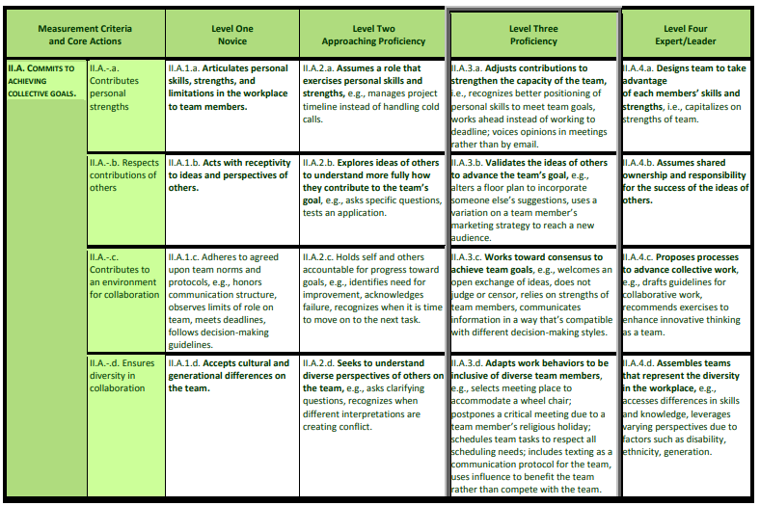
Components of an Analytic Rubric
Performance Levels
Skill Components
Descriptors
Skill
Notes:
Before we can define the elements within a rubric, let’s review the various components of each type of rubric. In an analytic rubric, the skills are typically listed on the far-left column. Some skills may need to be broken down further into skill components. If the skill is too broad or requires too much description to capture all the essential elements, it may be helpful to break into multiple skill components. For example, communication skills require multiple elements. Good communicators need to listen, speak clearly, and use and understand nonverbal cues. You may add additional skill components to help students, employers, and teachers understand all the elements involved with communication skills.
The performance levels are across the top of the rubric and describe the quality of performance for each skill. The descriptor provides the description of what each skill looks like across each level of performance.

Slide 14
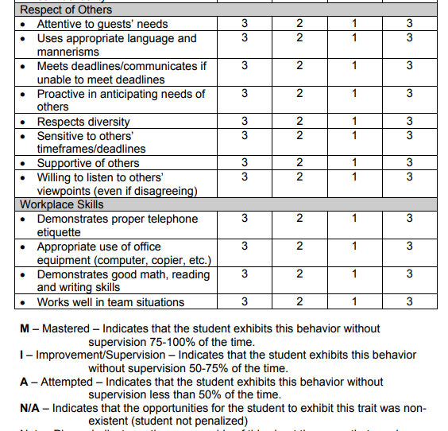
Components of a Holistic Rubric
Skill Components
Skills
Performance Levels
Descriptors
Notes:
The components of a holistic rubric are similar but located in different places. In this rubric, the skills are “respect of others” and “workplace skills,” which are then further broken down into skill components. The performance levels here are the rating scale, and the descriptors describe the quality of performance. However, in the holistic rubric the descriptors are the same for each skill.

Slide 15
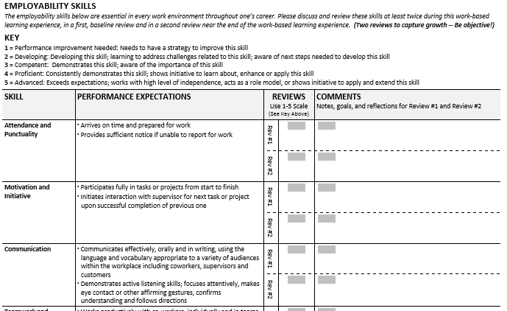
Holistic Example: Massachusetts
Source: Massachusetts Department of Elementary and Secondary Education, n.d.
Notes:
Here is an example of a holistic scale rubric from Massachusetts. This rubric measures skills such as attendance and punctuality, motivation and initiative, and communication. The descriptors are highlighted in the red box. Each skill is rated using this 1 to 5 scale, ranging from “Performance Improvement Needed” to “Advanced.” The description of performance is the same for all the skills.

Slide 16
Holistic Example: South Dakota
Source: South Dakota Department of Education, n.d., p. 78
Notes:
Here is a holistic example from South Dakota. Students are rated on skills and behaviors such as attentive to guests’ needs and demonstrates proper telephone etiquette. The descriptors are highlighted in the red box. In this example, the descriptors focus on the frequency with which students exhibit the behavior without supervision. Students can be rated as “mastered,” “improvement,” “attempted,” or “not applicable.”

Slide 17
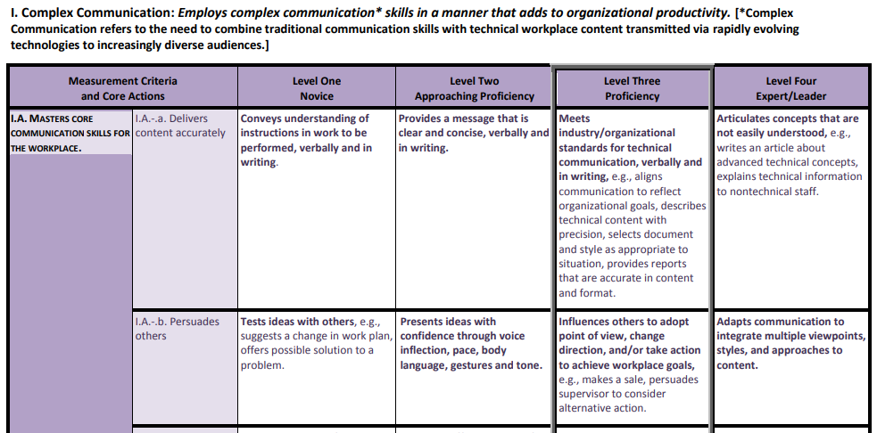
Analytic Example: Arizona
Source: Arizona Department of Education, 2012
Notes:
Here is an example of an analytic rubric from Arizona. This rubric is focused on communication and breaks it down to two criteria. How the performance is described across the performance levels is different for “delivers content accurately” and “persuades others.” This is the customized descriptor for each skill. An analytic rubric provides additional detail on what each skill looks like across multiple levels of performance.

Slide 18
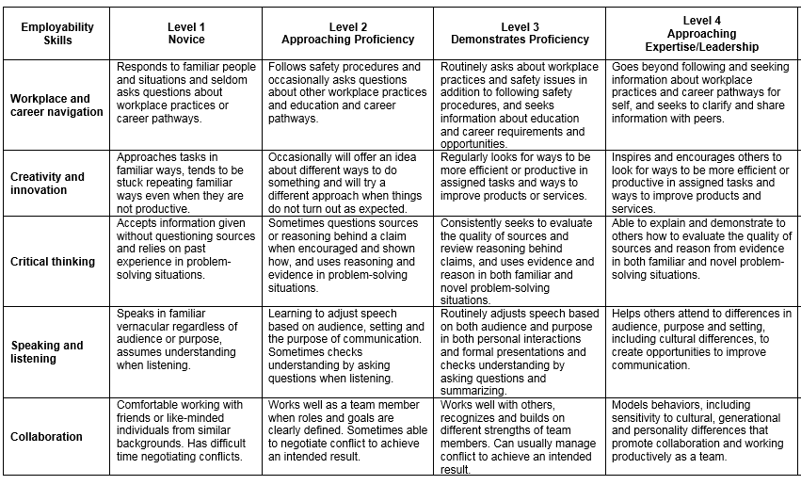
Analytic Example: Ohio
Source: Ohio Department of Education, n.d.
Notes:
Here is an analytic rubric example from Ohio. The scale provides a unique description of performance for all the skills, such as workplace and career navigation as well as creativity and innovation.

Slide 19
Discussion: Select the Type of Rubric
Refer to Handout 3, Decision Point 2.
In your teams, discuss and capture notes for the rubric type that best fits your state, district, or school.
Capture your final decision on the handout.
Notes:
In your team, use the Decision Point 2 section of the handout 3 to discuss and capture notes for the rubric type that best fits your local context.

Slide 20
Decision Point 3: Define the Rubric Skills
Notes:
Once you’ve determined which type of rubric, the next decision point is to define the skills for the artifact scoring rubric.

Slide 21
Guidance for Developing Skills
Skills emphasize what the student develops and learns during the course of the work-based learning experience.
In developing a rubric, skills should be:
Distinct and focused
Sequenced
Notes:
The skills within the rubric should focus on what the student develops or learns during the course of the work-based learning experience. The rubric should emphasize what is measured. Some examples could include employability skills or career readiness competencies. As you develop your rubric, it is important that the skills are distinct and focused so that they are clearly differentiated. Your rubric will be easier to follow if the skills are sequenced and build upon one another.

Slide 22
Types of Knowledge and Skills
Academic Knowledge
Knowledge and skills associated with subject-matter areas such as English, mathematics, and science
Technical Skills
Skills needed for specific occupations or careers
Employability Skills
General knowledge and skills that are necessary for success in the labor market at all employment levels in all sectors
Notes:
The content of the rubric should be based on the types of knowledge and skills you defined in Module 1. The knowledge and skills are what is measured from the work-based learning experience, and the rubric should go into greater detail describing what each knowledge and skill looks like across the various performance levels.

Slide 23
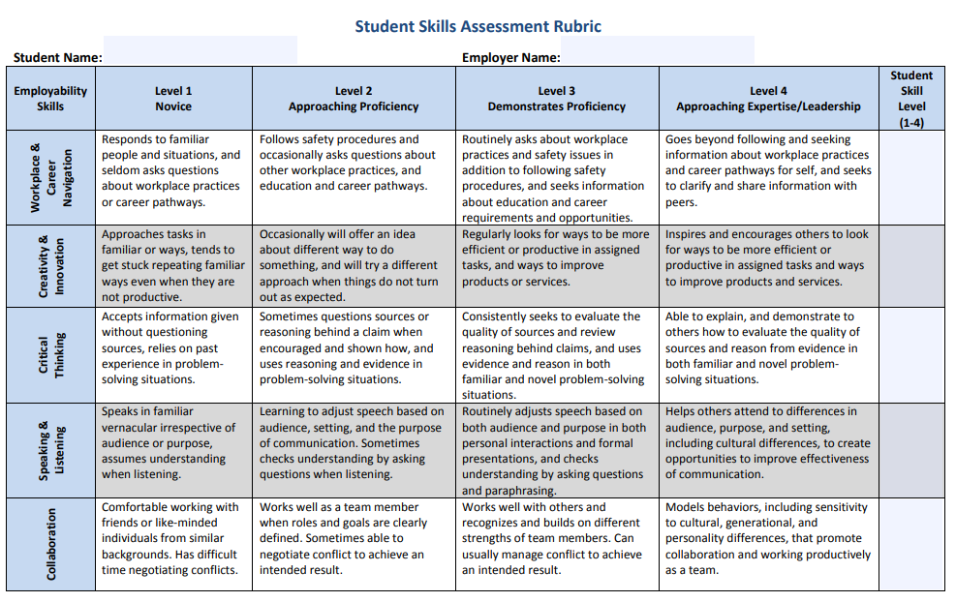
Skill Example: Tennessee
Source: Tennessee Department of Education, n.d.
Notes:
Here is a rubric example from Tennessee. This rubric defines employability skills but doesn’t break down to the skill component.

Slide 24
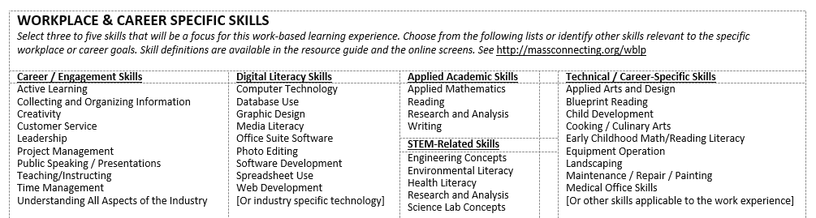
Skill Example: Massachusetts
Source: Massachusetts Office of Elementary and Secondary Education, n.d.
Notes:
Here is an example of technical skills from Massachusetts. It includes technical skills such as graphic design, photo editing, child development, and cooking.

Slide 25
Key Considerations for Defining Skills
Describe the skills in a concise and structured method so all stakeholders will comprehend.
Describe what each knowledge and skill looks like for students during a work-based learning experience.
Determine how will you see evidence of these skills.
Notes:
As you consider further defining the skills and knowledge within your rubric, there are a few key considerations. First, what does each knowledge and skill look like for students during a work-based learning experience? Your rubric will provide the details describing what each skill will look like in a work-based learning context that is developmentally appropriate at the student level. For example, what does customer service look like? The rubric may describe indicators such as responds to customers’ needs, seeks out resources for the customer, interacts politely, and provides alternative solutions.
As you develop the descriptors, it is important that you consider the source of evidence. Will you see evidence of this skill or knowledge in a student artifact or only by observing the student in the workplace? If you plan on the rubric being used in a portfolio assessing artifacts, then it is important that the skills and descriptors are evident in artifacts.
Each skill must be concise and structured so that students, educators, and employers can easily understand the rubric. For example, you may have one skill such as communication that includes many elements to describe what high-quality communication would look like in a workplace setting. Combining the text to describe speaking, listening, writing, and all the elements of communication may become too cumbersome. One strategy to address this issue is to break up the skills into skill components. This keeps the main component of communication while highlighting the various components in a concise, easy-to-understand method.

Slide 26




Approaches to Define Skills in Rubric
In-Person Meeting
Survey or Focus Groups
Review and Comment
Adopt National or Existing Framework
Notes:
As was described in Module 1, collecting stakeholder feedback is an excellent approach to help define the skills and skill components within your rubric. As you work with stakeholders to determine which types of knowledge and skills should be measured, you can work with this group further to get feedback on describing the skills within a rubric. You can collect stakeholder feedback from educators such as CTE teachers, counselors, work-based learning coordinators, administrators, and representatives from business and industry. To collect their feedback, you could convene in-person meetings to work together to define the knowledge and skills for the rubric, conduct a survey or focus group to gather their insights on the most critical skills, or have stakeholders review and comment on drafts of the rubric skills.
Another approach to help define the knowledge and skills is to adopt or modify a national or existing framework. This approach is particularly helpful for employability skills. In addition, industries or local employers may have existing lists that outline the types of skills and knowledge that they require from their employees that schools could adopt. These lists, particularly for any technical skills, may need to be modified so that they are attainable for students.

Slide 27
Discussion: Define Rubric Skills
Refer to Handout 3, Decision Point 3.
In your teams, discuss the guiding questions to help define the rubric skills.
For samples of skills, review Handout 1, Skills Bank.
Next, develop your stakeholder outreach plan to further determine rubric skills.
Notes:
To help you define the skills within your rubric, use the guiding questions on Handout 3, Decision Point 3.

Slide 28
Decision Point 4: Determine Rubric Performance Levels
Notes:
Decision Point 4 is to define the performance levels for the rubric.

Slide 29
What Are Performance Levels?
Differentiates the quality of the development of knowledge and skills.
Allows students, educators, and employers to determine progress or growth of skills.
Notes:
Performance levels describe students’ skill performance or development of specific skills across the multiple levels. They differentiate the quality of the development of knowledge and skills. By being able to see the difference in the quality of the skill development, students, educators, and employers can determine progress or growth of skills.

Slide 30
Steps to Determine Performance Levels
Determine the number of performance levels.
Determine how the performance levels will be represented (qualitative or quantitative).
Define the performance level labels.
Notes:
The first step to developing performance levels is to determine the number to include in the rubric. It is important that the rubric has sufficient number to capture student progress and growth but not so many performance levels that it becomes difficult to differentiate performance, particularly in the middle levels. To avoid an over scoring of average ratings, consider an even number of performance levels.
Next, determine how the performance levels will be represented either using qualitative or quantitative descriptions, or both. Quantitative labels may more easily translate to a weighted score or grade. However, relying on solely quantitative labels may encourage students to focus on the rating and not the description of the performance.
Finally, define the performance level labels. States and districts may want to use the same performance level labels as other existing rubrics particularly any focused on college and career readiness initiatives. It is important that any qualitative levels describe the quality of the performance at a student level.

Slide 31
Examples of State and District Performance Level Labels
State(s) or District | Type of Rubric | Number of Levels | Performance Labels
Arizona, Ohio, and Tennessee | Analytic | 4 | Level 1: Novice, Level 2: Approaching Proficiency, Level 3: Proficiency, and Level 4: Expert/Leader
Chicago | Analytic | 3 | Does Not Meet Standards, Meets Standards, and Exceeds Standards
Kansas City | Analytic | 6 | No labels
Los Angeles | Analytic | 4 | Emerging, Developing, Proficient, and Advanced
Massachusetts | Holistic | 5 | Performance Improvement Needed, Developing, Competent, Proficient, and Advanced
South Dakota | Analytic | 4 | Attempted, Improvement/Supervision, and Mastered
 | Holistic | 3 | Developing, Basic, Proficient, and Exemplary
Notes:
This table highlights the various performance level details from the rubrics we collected in our document scan. The majority of rubrics had four performance levels, and all the rubrics had three to six performance levels. The labels for the performance levels also varied with the majority using qualitative descriptors or both.

Slide 32
Discussion: Performance Levels
Refer to Handout 3, Decision Point 4.
In your teams, discuss and capture notes for the performance levels of your rubric that best fits your state, district, or school.
Capture your final decision on the handout.
Notes:
Use Handout 3, Decision Point 4 to discuss and capture your notes for determining your rubric’s performance levels.

Slide 33
Decision Point 5: Define Rubric Descriptors
Notes:
Once you’ve determined the skills and number of performance levels of your rubric, you will need to define the descriptors for the artifact scoring rubric.

Slide 34
What Are Descriptors?
A description of the quality or its absence for each knowledge and skill in the rubric.
The purpose of descriptors are to illustrate the quality of skill development to guide student improvement of those skills.
Notes:
In rubrics, descriptors are a description of the quality or its absence for each knowledge and skill. The purpose of descriptors is to illustrate the quality of skill development, which can help further guide students to improve on those skills.

Slide 35
Descriptors in Analytic Rubric
Performance Levels
Descriptors
Skill
Notes:
As a reminder, the descriptor provides the description of what each skill looks like across each level of performance in an analytic rubric. In a rubric with a holistic scale, the descriptors describe the level of performance.

Slide 36




Steps to Define Descriptors
Convene working group.
Review list of knowledge and skills.
Review existing frameworks and examples.
Define proficiency.
Notes:
The first step to define the rubric descriptors is to convene a working group of interested stakeholders. The group can include state or district policymakers, CTE teachers, counselors, work-based learning coordinators, and representatives from business and industry. The group will be actively involved in developing the rubric, so you may want to consider a manageable size of partners who will be invested in developing the rubric. This group could be a small sample of the stakeholders engaged in Module 1 to provide feedback on the knowledge and skills.
Next, have the working group members review the existing list of knowledge and skills identified in Module 1. This working group may review the feedback collected on the knowledge and skills and determine the final list of knowledge and skills to serve as the basis for the rubric. For a sample of existing knowledge and skills from other states and districts, review Handout 1, the Skills Bank, on page 12.
In addition to reviewing the list of knowledge and skills to serve as the basis of the rubric descriptors, the working group should review existing frameworks, career readiness standards, and other state or local examples to identify possible descriptor language and map to the skills of the rubric. These standards and examples will also serve as reference for the final step of defining proficiency.
The working group can define proficiency by first determining which performance level is proficient. In a rubric with four performance levels, the second to highest performance level is typically proficient. Then, as a group, they should develop a description of the quality of performance for each skill at the proficient level. One way to do this is to refer to the existing standards, frameworks, or examples for a definition of proficiency. Another approach is to analyze student work samples from work-based learning experiences with the working group. The analysis can help you identify the types of skills and knowledge students demonstrate from their work-based learning experience and develop a description. The group can analyze the work samples and sort the quality into the levels of performance. This sorting can help define what proficiency looks like for the rubric skills as well as the other performance levels. After the working group has defined the proficient level, complete the description for the remaining performance levels.

Slide 37
Considerations for Defining Descriptors
Parallel in sequence and build on one another
Consistent in grammatical style across skills and performance levels
Unique across performance levels (holistic) or skills (analytic)
Notes:
When developing the descriptors, it is important that they are parallel in sequence and build upon one another. The descriptors need to have consistent grammatical style across skills and performance level. In addition, they should be unique across skills and performance levels to ensure that students, employers, school staff, and others reviewing student performance can differentiate between the skills and performance levels. If you’ve described two descriptors too similarly, it will become difficult to interpret student development of those skills and to provide valid and reliable results.

Slide 38
Approaches for Defining Holistic Rubric Descriptors
Quality Descriptors
Describes the quality of student performance or skill development.
Frequency Descriptors
Provides a numerical account of how often a student demonstrates or performs a skill.
Notes:
In a holistic rubric, there are common descriptors that are used across all the skills to describe the quality of student performance. There are two common approaches to defining descriptors for a holistic rubric: quality and frequency. The quality approach focuses on describing the quality of the student performance or skill development. These descriptors often start with a Likert-scale statement and then further describe what the scale means in quality of performance. The second approach focuses on the frequency with which a student demonstrates or performs a skill or behavior. For example, a student is “advanced” if he or she demonstrates the skill or behavior 70% or more of the time.

Slide 39
Example of Quality Descriptor
Source: Massachusetts Department of Elementary and Secondary Education, n.d.
Notes:
Here is an example of the quality approach from Massachusetts. The descriptors focus on describing the quality of performance for skill from “performance improvement needed” to “advanced.”

Slide 40
Example of Frequency Descriptor
Source: South Dakota Department of Education, n.d., p. 78
Notes:
Here is an example of the frequency approach from South Dakota. You can see the descriptors describe the frequency of the student behavior from “mastered” to “attempted.”

Slide 41
Activity: Define Descriptors
Refer to Handout 3, Decision Point 5.
With your working group, follow the instructions in the handout to define your rubric descriptors.
Note your draft descriptors in the handout.
Notes:
Once you’ve convened your working group, use the guidance on Handout 3, Decision Point 5 to define your rubric descriptors. Use the handout and guidance to create draft rubric descriptors.

Slide 42
Wrap-Up

Slide 43
Key Decisions
Determine the purpose of the rubric.
Select the rubric type.
Define the rubric skills.
Define rubric performance levels.
Define rubric descriptors.
Notes:
This third module in our work-based learning measures series focused on the five key decisions to develop a rubric to measure work-based learning. We discussed the various purposes of using a rubric and the importance of selecting the type of rubric, either holistic or analytic. The third decision point addressed was defining the skills for the rubric and then the performance levels. Finally, we highlighted how to define the descriptors for the rubric.

Slide 44
Additional Modules
Module 1: Selecting Appropriate Measures
Module 2: Developing Portfolios
Module 3: Designing Rubrics
Module 4: Constructing Employer Feedback and Evaluation
Module 5: Creating Student Self-Assessments
Notes:
As a reminder, this module is part of a series on measuring work-based learning. Please feel free to return to Module 1, which introduces the modules and provide more details on defining skills and knowledge. If you are considering using a rubric with a portfolio, we recommend that you also complete Module 2 focused on portfolios. We have additional modules that outline the decision points to create employer feedback measures and student self-assessments. You may want to review these modules as additional items to include in your portfolios.

Slide 45
References
Acosta, T., & Lin, Y. (2006). ePortfolios: Beyond assessment. In A. Jafari & C. Kaufman (Eds.), Handbook of research on ePortfolios (pp. 15–23). Hershey, PA: Idea Group Reference.
Arizona Department of Education. (2012). Complex communication. Phoenix, AZ: Author. Retrieved from https://cms.azed.gov/home/GetDocumentFile?id=589b42671130c10810eaeac7
Bissell, A. N., & Lemons, P. P. (2006). A new method for assessing critical thinking in the classroom. BioScience, 56, 66–72. https://doi.org/10.1641/0006-3568(2006)056[0066:ANMFAC]2.0.CO;2
Jonsson, A., & Svingby, G. (2007). The use of scoring rubrics: Reliability, validity, and educational consequences. Educational Research Review, 2, 130–144.
Massachusetts Department of Elementary and Secondary Education. (n.d.). Massachusetts work-based learning plan. Malden, MA: Author. Retrieved from http://skillspages.com/documents/masswblp.doc
Mertler, C. (2001). Designing scoring rubrics for your classroom. Practical Assessment, Research & Evaluation, 7(25). Retrieved from http://www.pareonline.net/getvn.asp?v=7&n=25
Morrison, G. R., & Ross, S. M. (1998). Evaluating technology-based processes and products. New Directions for Teaching and Learning, 74, 69–77.

Slide 46
References
Moskal, B. (2003). Recommendations for developing classroom performance assessments and scoring rubrics. Practical Assessment, Research & Evaluation, 8(14). Retrieved from http://pareonline.net/getvn.asp?v=8&n=14
Ohio Department of Education. (n.d.). Student skills assessment rubric. Columbus, OH: Author. Retrieved from http://education.ohio.gov/getattachment/Topics/Career-Tech/Career-Connections/Work-Based-Learning/Work-Based-Learning-for-Students-and-Familes/StudentSkillsAssessmentRubric.docx.aspx
Perlman, C. (2002). An introduction to performance assessment scoring rubrics. In C. Boston (Ed.), Understanding scoring rubrics: A guide for teachers (pp. 5–13). Retrieved from https://files.eric.ed.gov/fulltext/ED471518.pdf
Schamber, J. F., & Mahoney, S. L. (2006). Assessing and improving the quality of group critical thinking exhibited in the final projects of collaborative learning groups. Journal of General Education, 14, 151–170.
Shaw, J. (2004). Demystifying the evaluation process for parents: Rubrics for marking student research projects. Teacher Librarian, 37, 16–19.

Slide 47
References
South Dakota Department of Education. (n.d.). Youth internship program framework. Pierre, SD: Author. Retrieved from https://doe.sd.gov/cte/documents/YI_Manual.pdf S
Smith, J., & Hanna, M. A. (1998). Using rubrics for documentation of clinical supervision. Counselor Education and Supervision, 37, 269–278.
Tennessee Department of Education. (n.d.). Student self-assessment of skills. Nashville, TN: Author. Retrieved from https://www.tn.gov/content/dam/tn/education/ccte/wbl/wbl_wbl_student_self_assessment_of_skills.pdf.
Wiggins, G. (1998). Educative assessment. San Francisco, CA: Jossey-Bass
Wiggins, G., & McTighe, J. (2004). Understanding by design. Alexandra, VA: ASCD.

Slide 48
1000 Thomas Jefferson Street NW
Washington, DC 20007
800-634-0503
www.ccrscenter.org | ccrscenter@air.org
This work was originally produced in whole or in part by the College and Career Readiness and Success Center with funds from the U.S. Department of Education under cooperative agreement number S283B120034. The content does not necessarily reflect the position or policy of the Department of Education, nor does mention or visual representation of trade names, commercial products, or organizations imply endorsement by the federal government.
Copyright © 2019 American Institutes for Research. All rights reserved.

