Slide 1

Module 2: Developing Portfolios
Work-Based Learning Measures Series
  [Insert Name]
    [Insert Position]
      [Insert Month 20XX]
Notes:
Thank you for visiting the College and Career Readiness and Success Center’s (CCRS Center’s) series Work-Based Learning Measures. You are in Module 2: Developing Portfolios. This module will outline the key decisions points state and district teams need to consider to develop a portfolio to measure student learning from work-based learning experiences.

Slide 2
Work-Based Learning Module Series
Module 1: Selecting Appropriate Measures
Module 2: Developing Portfolios
Module 3: Designing Rubrics
Module 4: Constructing Employer Feedback and Evaluation
Module 5: Creating Student Self-Assessments
Notes:
This module is part of a five-part series. We recommend that you first review Module 1, Selecting Appropriate Measures, before continuing in this module. The first module provides an overview of the various types of measures and outlines decisions points needed to select which type of measure will best fit your local context and needs. If you are using portfolios to measure work-based learning, we recommend that you also complete Module 3, which outlines the key decision points to create a rubric to score the artifacts within your portfolio. Module 4 focuses on the decision points to develop employer feedback, and Module 5 highlights the decision points to create a student self-assessment. For this module, we’ll be taking a deep dive on portfolios.

Slide 3
Objectives
Explore portfolios as a possible measure of work-based learning.
Discuss the key decisions needed to develop a portfolio to assess work-based learning experiences.
Notes:
Our objectives for this module is to help you understand the benefits of portfolios and discuss the decision points needed to develop a portfolio to assess work-based learning experiences.

Slide 4
Overview of Portfolios
Notes:
We will start this module by providing an overview of portfolios and highlight some of their benefits for measuring work-based learning.

Slide 5


Measures of Work-Based Learning
States reviewed: 17
Districts reviewed: 59
Total resources reviewed: 109
Employer evaluations: 30
Rubric: 23
Self-assessments/Reflections: 19
Worklogs: 7
Portfolios: 5
Notes:
To learn how states and districts measure work-based learning, the College and Career Readiness and Success Center (CCRS Center) conducted a document scan collecting and analyzing work-based learning measures. States selected included leaders in work-based learning and states who specified in their state Every Student Succeeds Act (ESSA) plans that they plan to use work-based learning as an indicator of career readiness in their state accountability. We also collected documents from the largest two to four districts in each state. In addition to the measures, we collected related work-based learning resources such as guidebooks and presentations that often include the context on how to implement the measure. We searched for resources publicly available on state or district websites and found a total of 109 work-based learning measures and resources. This included 30 employer evaluations, 23 rubrics, 19 self-assessments or self-reflections, seven worklogs, and five portfolios. The information and decision points were developed based on an analysis of the document scan and a literature scan on each type of measure.

Slide 6
What Can Portfolios Do?
Demonstrate learning across time
(Shulman, 1998; Wade, Abrami, & Sclater, 2005).
Provide a platform for self-promotion and future employment
(Wade et al., 2005).
Promote collaboration, promote reflection, and shift demonstration of learning to the student
(Shulman, 1998).
Connect knowledge gained in the academic context with other contexts, such as the workplace
(Acosta & Liu, 2006; Light, Sproule, & Lithgow, 2009; Wuetherick & Dickinson, 2015).
Notes:
What can portfolios do to assess student learning from work-based learning? Portfolios demonstrate student learning across time. Students can collect work samples from eighth grade through high school and from multiple types of work-based learning experiences. Portfolios can connect knowledge gained in the academic context with other contexts such as the workplace. In addition, portfolios provide a platform for self-promotion and future employment. For example, students may need a portfolio to apply for certain jobs, such as an architect, or professions, such as marketing. The process of creating a portfolio promotes collaboration and self-reflection, and it shifts the demonstration of learning to the student. Because students lead the development of the portfolio with support from school staff and employers, they can take greater ownership in the process.

Slide 7
Decision Points
Determine the purpose of the portfolio.
Select the type of portfolio.
Determine the artifacts required in the portfolio.
Identify who selects portfolio artifacts.
Determine portfolio scoring.
Notes:
There are five decision points that state and district teams will need to consider to develop a work-based learning portfolio. This first is to determine the purpose of the portfolio. The second is to select the type of portfolio. The third decision point is to determine the artifacts that will be required in the portfolio. The fourth is to identify who selects the portfolio artifacts. The fifth decision point is to determine the summative portfolio scoring process.

Slide 8
Decision Point 1: Determine the Purpose of the Portfolio
Notes:
The first decision point is to determine the purpose of the portfolio.

Slide 9
Purposes of Portfolios
Student Progress: Evaluating individual student progress, grading, or certifying an accomplishment
Instructional: Diagnosing students’ needs, informing instructional planning, or improving instructional effectiveness
Student Efficacy: Encouraging student efficacy, promoting student self-assessment, or motivating student performance
Communication: Communicating with parents and employers
Source: Herman, Gearheart, & Aschbacher, 1996
Notes:
There are four common local portfolio purposes: student progress, instructional, student efficacy, and communication. If your portfolio’s purpose is student progress, then your goal is to evaluate individual student progress, grading, or certifying an accomplishment. Another portfolio purpose is instructional, which helps to diagnose students’ needs, inform instructional planning, or improve instructional effectiveness. Student efficacy promotes student self-assessment or motivates student performance. Lastly, the purpose of your portfolio could be for communication, such as communicating students’ skills and strengths with parents and employers.

Slide 10
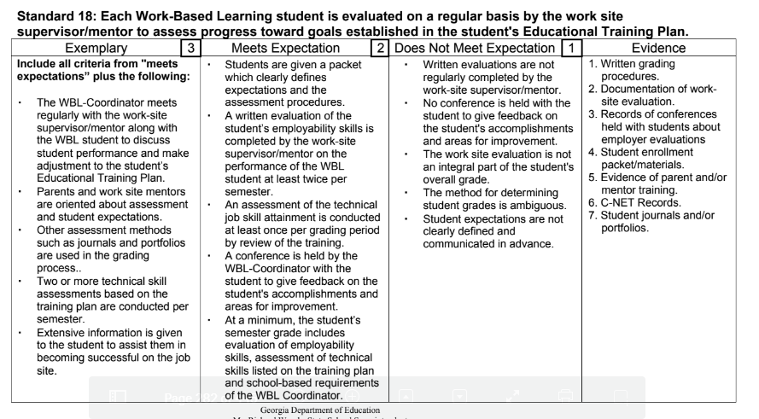
Student Progress Example: Georgia
Source: Georgia Department of Education, 2016, p. 282
Notes:
This example from Georgia shows that the purpose of the portfolio is student progress. This is a snapshot of Georgia’s work-based learning standards. In the highlighted box, you can see that portfolios can be used in the grading process. In Georgia, one purpose of portfolios is to provide students with a grade to measure student progress.

Slide 11
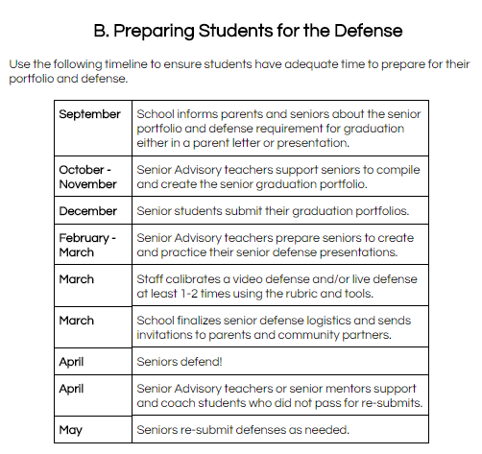
Communication Example: Los Angeles
Source: Los Angeles Unified School District, 2017, p. 10
Notes:
This example from Los Angeles shows a communication purpose. In Los Angeles, students are required to submit a graduation portfolio and give a presentation on the portfolio to parents and community partners. In the highlighted box, you can see that students will communicate their portfolio during their senior defense to parents and community partners.

Slide 12
Discussion: Portfolio Purpose
Use the Module 2 handouts and refer to Decision Point 1.
In your teams, discuss and complete the checklist for portfolio purposes that best fits your state, district, or school.
Capture your final decision on the handout.
Notes:
In your team, discuss and decide which purpose for using a portfolio would best fit your state, district, or school. Use the checklist found in the Module 2 handouts for Decision Point 1. Discuss and complete the checklist to help your team determine which purpose for using a portfolio. Record your final decision in the handout.

Slide 13
Decision Point 2: Select the Type of Portfolio
Notes:
After you’ve identified your purpose for using portfolios, you will need to select the type of portfolio.

Slide 14
Types of Portfolios
Showcase: The best work
Growth: Evidence of growth across time
Working: Draft and final artifacts
Source: Herman et al., 1996; Stiggins, 1994
Notes:
There are three types of portfolios: showcase, growth, and working. A showcase portfolio only includes the best student work. Students with support from school staff select which of their work samples best demonstrate the development of skills and knowledge. A growth portfolio assesses evidence of student growth across time. This doesn’t just include the best work at one point in time but the best work across multiple points of time. This could be over the course of one school year or over a student’s high school career. A working portfolio includes all of the student work. This is not just the best work but it could even include drafts or earlier versions. This enables the student and teacher to provide formative feedback over time on the working materials.

Slide 15
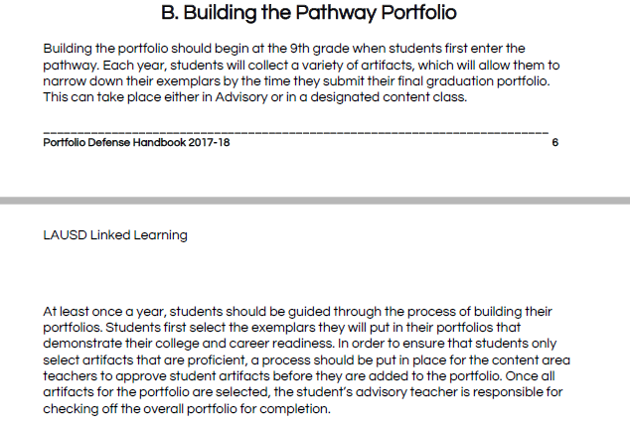
Showcase Example: Los Angeles
Source: Los Angeles Unified School District, 2017, p. 6
Notes:
Here is an example of using a showcase portfolio from Los Angeles. This comes from their guidebook. In Los Angeles, students submit student work samples beginning in 9th grade until their senior year when they select all the best work to create a showcase portfolio.

Slide 16
Discussion: Type of Portfolio
Refer to Handout 2, Decision Point 2.
In your teams, discuss and capture notes for the type of portfolio purpose that best fits your state, district, or school.
Capture your final decision on the handout.
Notes:
In your teams, select which type of portfolio would work best for your state, district, or school. Use the handout to capture your notes, ideas, and questions from the discussion. The handout has space to note your team’s final decision.

Slide 17
Decision Point 3: Determine the Artifacts Required in the Portfolio
Notes:
The next decision point is to determine which artifacts will be required to include in the portfolio.

Slide 18
Considerations for Selecting Portfolio Artifacts
Involves considerable amount of student choice
Includes students’ explanation for selection of products
Based on the portfolio purpose and instructional outcomes
Includes a representative sample of students’ accomplishments and work
Provides evidence of knowledge and skill development
Source: Zubizarreta, 2008
Notes:
When determining what artifacts to include in the portfolio, it is important to consider that portfolios are not simply a scrapbook of student work but a process that facilitates student reflection and metacognition. To support this deeper learning, it is important that students have choice in selecting the artifacts. To further promote reflection, students should include an explanation for why they selected or included each artifact in the portfolio—for example, having students write how a presentation demonstrates their communication skills. However, students may need some guidance on how to select the artifact. To determine which artifacts to include, it is important that the artifacts align to the portfolio purpose and instructional outcomes. Those goals should be the driver for selecting which artifacts to include. The number of artifacts should be a representative sample of the student’s accomplishments and work and provides enough evidence of the student’s knowledge and skills.

Slide 19
Sample Portfolio Artifacts
Background
  Introduction letter
  Table of contents
Postsecondary Planning
  Résumé
  Letters of recommendation
  Job or college application
Assessments
  Employer
  Teacher/work-based learning
  coordinator
  Student
Work samples
  Describes the work-based learning experience
  Identifies skills(s) demonstrated
  Reflects on what was learned (skills or content)
Notes:
Portfolios can include a variety of artifacts and student work samples to demonstrate students’ career readiness. Many portfolios include not only artifacts explicitly connected to the work-based learning experiences but a broader set of artifacts that demonstrate a student’s career readiness. Some common artifacts include some background information, such as an introduction letter that may describe the student’s career goals and a table of contents. Another type of artifact is postsecondary planning artifacts such as a résumé, letters of recommendation, or a job or college application. The portfolio can also hold an assortment of evaluations or assessments completed by either the employer or student. Another key type of portfolio artifact is work samples that are produced during the work-based learning experience. The work samples are some product that the student creates or produces during the course of their work-based learning experience and demonstrates the skills outlined in the rubric. Some examples can include presentations, reports, research papers, or spreadsheets. With the work sample, the student typically describes the work-based learning experiences, identifies the skill or skills demonstrated, and reflects on what was learned either as part of the work sample or through journaling. States may decide to require specific artifacts such as a résumé or work-based learning artifacts or require types and give districts and schools the flexibility to choose the specific artifacts.

Slide 20
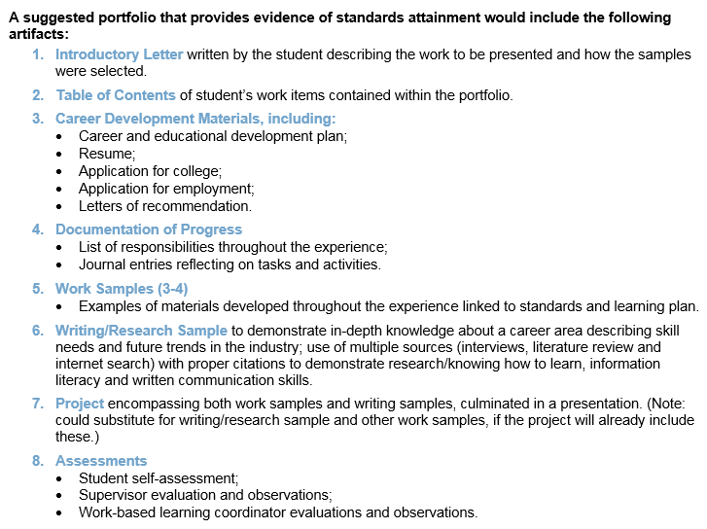
Portfolio Requirements: Ohio
Source: Ohio Department of Education, 2016
Notes:
Here is an example of the suggested portfolio artifacts in Ohio. It includes an introduction letter, table of contents, career development materials such as résumé, documentation of progress, work samples, project, and assessments.

Slide 21
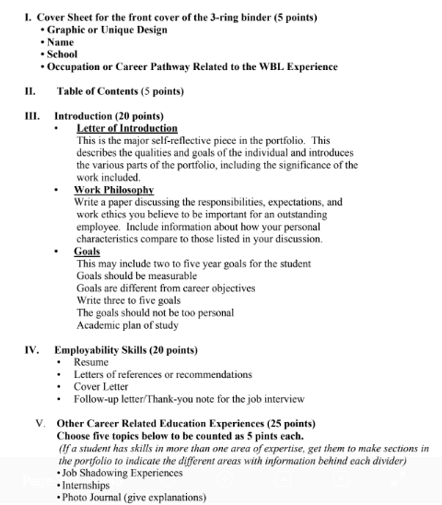
Portfolio Requirements: Georgia
Source: Georgia Department of Education, 2016, p. 294
Notes:
Here is an example of the portfolio content in Georgia. It includes similar things to Ohio such as a letter of introduction and résumé. However, it also includes items like goals and work philosophy.

Slide 22
Activity: Portfolio Artifacts
Refer to Handout 2, Decision Point 3.
In your teams, brainstorm possible artifacts for the portfolio for each knowledge and skill identified in Module 1. Identify any potential gaps for each knowledge and skill missing an artifact.
Capture your final decision on the required or recommended artifacts on the handout.
Notes:
In your team, brainstorm a list of possible artifacts using the Decision Point 3 section of the handouts. Note the knowledge and skills that each artifact could possibly demonstrate that you selected in Module 1 (or in your rubric from Module 3). Review your list, and note the knowledge and skills that are missing a corresponding artifact. Then brainstorm any possible artifact that could serve as evidence for the missing knowledge and skills. This will help ensure you have a comprehensive list of possible artifacts that could serve as sources of evidence for each knowledge and skill you wish to assess.

Slide 23
Decision Point 4: Identify Who Selects Portfolio Artifacts
Notes:
The next decision point is to identify who selects the portfolio artifacts.

Slide 24



Selecting Artifacts
Student
Educator
Student with educator feedback
Source: Colette, Woliver, Bingman, & Merrifield, 1996; Zubizarreta, 2008
Notes:
There are several possible options for who selects the portfolio artifacts including students, teachers, work-based learning coordinators, and counselors. Or the student could select artifacts in consultation with a teacher or counselor or with final approval from an adult. If one of the purposes for measuring work-based learning is to support student efficacy then students should have some role in selecting the artifacts.
There are some benefits and challenges to having a single person versus a diversity of people involved in selecting the artifacts. In order for students to gain any learning benefits from the portfolio, students must do the work of self-assessment, reflection, and analysis. This will require students having a leading role in selecting the artifacts. If a student alone selects the artifacts, this may encourage student efficacy but the student may miss including key artifacts that demonstrate critical skills and knowledge even if they did do work that demonstrates those skills. In addition, if an educator selects the artifacts alone, he or she may select the strongest artifacts but the student has now missed out on an opportunity to reflect on their work and demonstration of skills. Having the student and teacher work together either by providing the student feedback or giving final approval are a few strategies to ensure that the portfolio is high-quality and promotes student learning in the measurement process. Educators can help mentor and facilitate students through the process of self-assessment, reflection, and analysis as students work on their portfolio.

Slide 25
Example: Los Angeles
Source: Los Angeles Unified School District Linked Learning, 2017, p. 6
Notes:
Here is an example from Los Angeles. Students select the exemplars that will be put in their portfolios, but teachers approve the final artifacts.

Slide 26
Discussion: Selecting Artifacts
Refer to Handout 2, Decision Point 4.
In your teams, discuss and capture notes for who selects the artifacts that best fit your state, district, or school.
Capture your final decision on the handout.
Notes:
In your teams, discuss and select the option for who select the portfolio artifacts that would work best for your state, district, or school. Use the Decision Point 4 section of the handout to capture your notes and final decision.

Slide 27
Decision Point 5: Determine Portfolio Scoring
Notes:
The next decision point is to determine how to score the whole portfolio.

Slide 28
Approaches to Scoring Portfolios
Rubric
Describes the knowledge and skills across performance levels
Weighted
Assigns point value sections
of the portfolio
Notes:
There are two approaches to scoring portfolios. The first is to create a portfolio scoring rubric. This could be different from the artifact scoring rubric or the same depending on the content within your portfolio. For example, some states have created an employability skills rubric to score the work-based learning work samples and a separate rubric to score the portfolio that is more comprehensive in assessing career readiness. This approach focuses on measuring the development of career-ready knowledge and skills but may be more challenging for schools and educators to implement. It will require more training and guidance on how to use the rubric to score the artifacts within the portfolio and to ensure that all stakeholders have a common understanding of the descriptions within the rubric.
The second common approach to scoring portfolios is weighted, which assigns point values to pieces or sections of the portfolio. This approach is simple and easy for educators to implement. However, by assigning points to particular components of the portfolio, it moves the process away from measuring the development of career-ready knowledge and skills. In addition, you will need to develop some guidance on how much flexibility educators have in awarding points. Does the student receive all the points for completing the artifact, or can educators use their judgement on quality to assign points within a range?

Slide 29
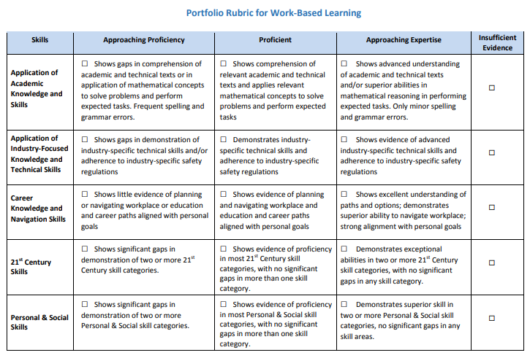
Example of a Portfolio Rubric: Tennessee
Source: Tennessee Department of Education, n.d.
Notes:
Here is an example of a portfolio rubric from Tennessee. Some of the descriptors in this rubric go beyond demonstrating skills but also highlight broader career readiness. For example, the approaching expertise level of “career knowledge and navigation skills” addresses that the student demonstrates excellent understanding of pathways and options.

Slide 30
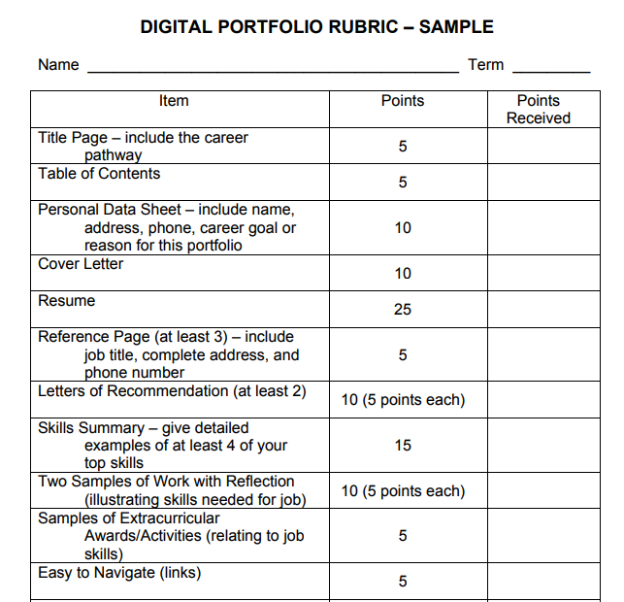
Example of Weighted Scoring: South Dakota
Source: South Dakota Department of Education, n.d., p. 46
Notes:
Here is a weighted example from South Dakota that assigns a specific point value to each item or section within the portfolio.

Slide 31
Aligning the Scoring Approach to the Purpose
Purpose | Rubric | Weighted
Student progress | X
Instruction | X
Student efficacy | X | X
Communication | X | X
Notes:
It is important that your summative scoring approach aligns with your portfolio purpose. If your purpose is to have data to give students instructional feedback on the development of specific employability skills, then the rubric approach would be a better fit for that purpose.

Slide 32
Key Considerations for Weighted Approach
How do you weigh the different artifacts within the portfolio?
How will educators award points for each artifact?
Notes:
There are some key considerations for the weighted approach as well. First, how do you weigh the different artifacts within the portfolio? You may want to weight each artifact equally within the portfolio or some artifacts more based on their importance or the amount of effort by the student. The different weights can help signify the importance of particular artifacts for students. Secondly, how will educators award points for each artifact? Do your students get the full points for completing the artifact or is there a range of possible points for each artifact that the educator can award. If you want educators to award points varying by quality, you will need to consider how educators will determine the quality of the artifact.

Slide 33
Activity: Determine Portfolio Scoring
In your teams, discuss and determine which summative scoring approach would work best for you. Use the “Selecting an Approach” section of Handout 2, Decision Point 5 to capture your notes and decision.
If you select rubric, please complete Module 3: Designing Rubrics for the key decision points on developing a work-based learning rubric.
If you select the weighted approach, Handout 2, Decision Point 5 provides the steps to develop the weighted summative scoring approach.
Notes:
In a team, determine which summative scoring approach best fits your local context. If you decide the rubric approach, please review the steps within Module 3 to help develop your rubric. If you select the weighted approach, there are additional guiding questions on the Decision Point 5 handout to develop that approach.

Slide 34
Wrap-Up

Slide 35
Key Decisions
Determine the purpose of the portfolio.
Select the type of portfolio.
Determine the artifacts required in the portfolio.
Identify who selects portfolio artifacts.
Determine portfolio scoring.
Notes:
During this module, we discussed the five key decisions to develop a work-based learning portfolio. The first was to determine the purpose of the portfolio and then select the type of portfolio. The third decision point was to determine the artifacts required for the portfolio. The fourth decision point was to identify who selects the portfolio artifacts and then finally determine the summative portfolio scoring approach.

Slide 36
Additional Modules
Module 1: Selecting Appropriate Measures
Module 2: Developing Portfolios
Module 3: Designing Rubrics
Module 4: Constructing Employer Feedback and Evaluation
Module 5: Creating Student Self-Assessments
Notes:
As a reminder, this module is part of a series on measuring work-based learning. Module 1 introduced various work-based learning measures and outlined the decision points to select an appropriate measure. Module 3 discusses the decisions points to develop a rubric that you may want to review if you’ve not done so yet and are interested in using a rubric for your summative scoring approach. The fourth module discusses the decision points for creating employer feedback, and the final module discusses student self-assessments. If you are considering these measures as possible artifacts within your portfolio, we recommend you review the decision points in these modules as well.

Slide 37
References
Acosta, T., & Liu, Y (2006). ePortfolios: Beyond assessment. In A. Jafari & C. Kaufman (Eds.), Handbook of research on ePortfolios (pp. 15–23). Hershey, PA: Idea Group Reference.
Colette, M., Woliver, B., Bingman, M. B., & Merrifield, J. (1996). Getting there: A curriculum for people moving into employment. Knoxville: University of Tennessee, Center for Literacy Studies.
Georgia Department of Education. (2016). Work-based learning: Including standards and activities for career-related education. Atlanta, GA: Author. Retrieved from https://www.dropbox.com/sh/b7cmfmg86wk2575/AABojjezjoodzGBJWFbIa2sfa?dl=0&preview=Complete+WBL+Manual_Printing+Caution_+Over+200+pages.pdf
Herman, J. L., Gearheart, M., & Aschbacher, P. R. (1996). Portfolios for classroom assessment: Design and implementation issues. In R. Calfee & P. Perfumo (Eds.), Writing portfolios in the classroom: Policy and practice, promise and peril (pp. 27–62). Mahwah, NJ: Erlbaum. Retrieved from http://files.eric.ed.gov/fulltext/ED398588.pdf
Los Angeles Unified School District. (2017). Portfolio-defense handbook 2017–18: A guide for LAUSD Linked Learning Pathways. Los Angeles, CA: Author. Retrieved from https://docs.google.com/document/d/1mf7SG_8OpYotoVoCKNi6j8luYKfEUb94WUU19UqiXuE/edit

Slide 38
References
Light, T. P., Sproule, B., & Lithgow, K. (2009). Connecting contexts and competencies. In D. Cambridge, B. Cambridge, & K. B. Yancey (Eds.), Electronic portfolios 2.0: Emergent research on implementation and impact (pp. 69–80). Sterling, VA: Stylus.
Nicol, D. J., & Macfarlane-Dick, D. (2006). Formative assessment and self-regulated learning: A model and seven principles of good feedback practice. Studies in Higher Education, 31(2), 199–218.
Ohio Department of Education. (2016). Work-based learning student reflection questions. Columbus, OH: Author. Retrieved from http://education.ohio.gov/getattachment/Topics/Career-Tech/Career-Connections/Work-Based-Learning/Work-Based-Learning-for-Students-and-Familes/Student-Reflection-Questions.docx.aspx
Shulman, L. (1998). Teacher portfolios: A theoretical activity. In N. Lyons (Ed.), With portfolio in hand
(pp. 23–38). New York, NY: Teachers College Press.
South Dakota Department of Education. (n.d.). Youth internship program framework. Pierre, SD: Author. Retrieved from https://doe.sd.gov/cte/documents/YI_Manual.pdf
Stiggins, R. J. (1994). Student-centered classroom assessment. New York, NY: Merrill.

Slide 39
References
Tennessee Department of Education. (n.d.). Portfolio rubric [supplemental materials to the WBL Implementation Guide]. Nashville, TN: Author. Retrieved from https://www.tn.gov/content/dam/tn/education/ccte/wbl/wbl_portfolio_rubric.pdf
Wade, A., Abrami, P. C., & Sclater, J. (2005). An electronic portfolio to support learning. Canadian Journal of Learning and Technology, 31(3). Retrieved from https://www.cjlt.ca/index.php/cjlt/article/view/26489/19671
Wuetherick, B., & Dickinson, J. (2015). Why ePortfolios? Student perceptions of ePortfolio use in continuing education learning environments. International Journal of ePortfolio, 5(1), 39–53.
Zubizarreta, J. (2008). The learning portfolio for improvement and assessment of significant student learning. In L. Clark & J. Zubizarreta (Eds.), Inspiring exemplary teaching and learning: Perspectives on teaching academically talented college students (121–136). Lincoln, NE: National Collegiate Honors Council.

Slide 40
1000 Thomas Jefferson Street NW
Washington, DC 20007
800-634-0503
www.ccrscenter.org | ccrscenter@air.org
This work was originally produced in whole or in part by the College and Career Readiness and Success Center with funds from the U.S. Department of Education under cooperative agreement number S283B120034. The content does not necessarily reflect the position or policy of the Department of Education, nor does mention or visual representation of trade names, commercial products, or organizations imply endorsement by the federal government.
Copyright © 2019 American Institutes for Research. All rights reserved.

